Slide 1

Mathematics for Computer Science

Slide 2
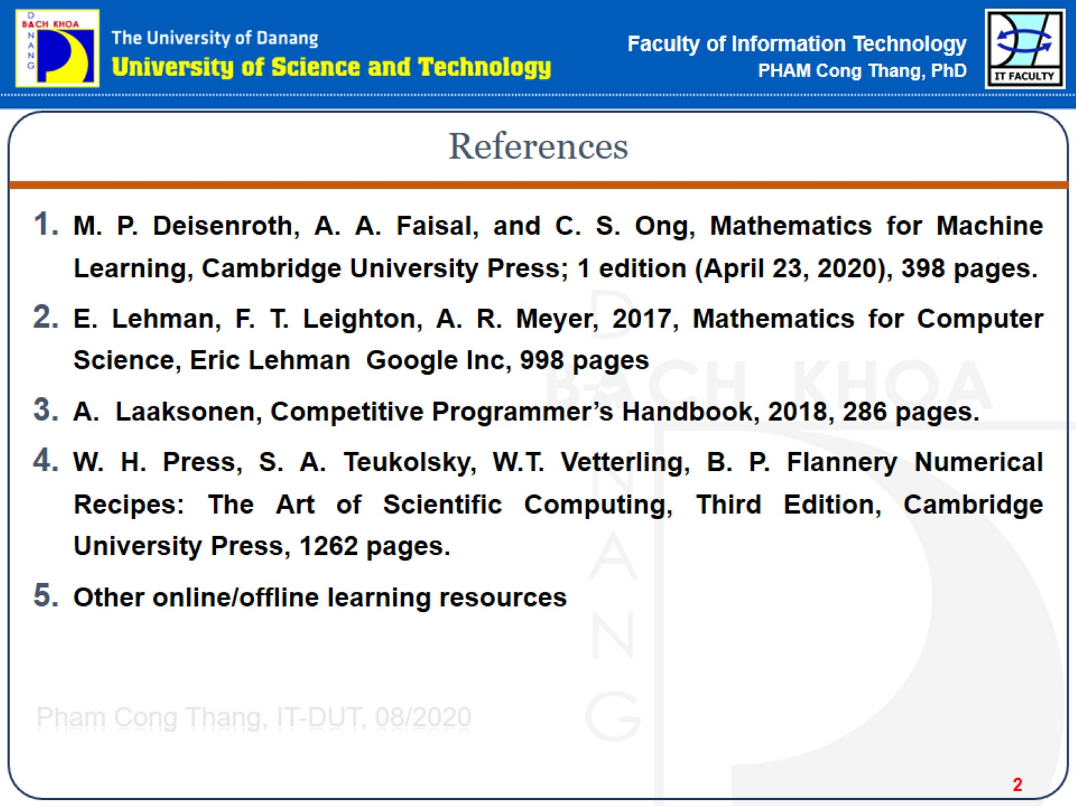
References

Slide 3
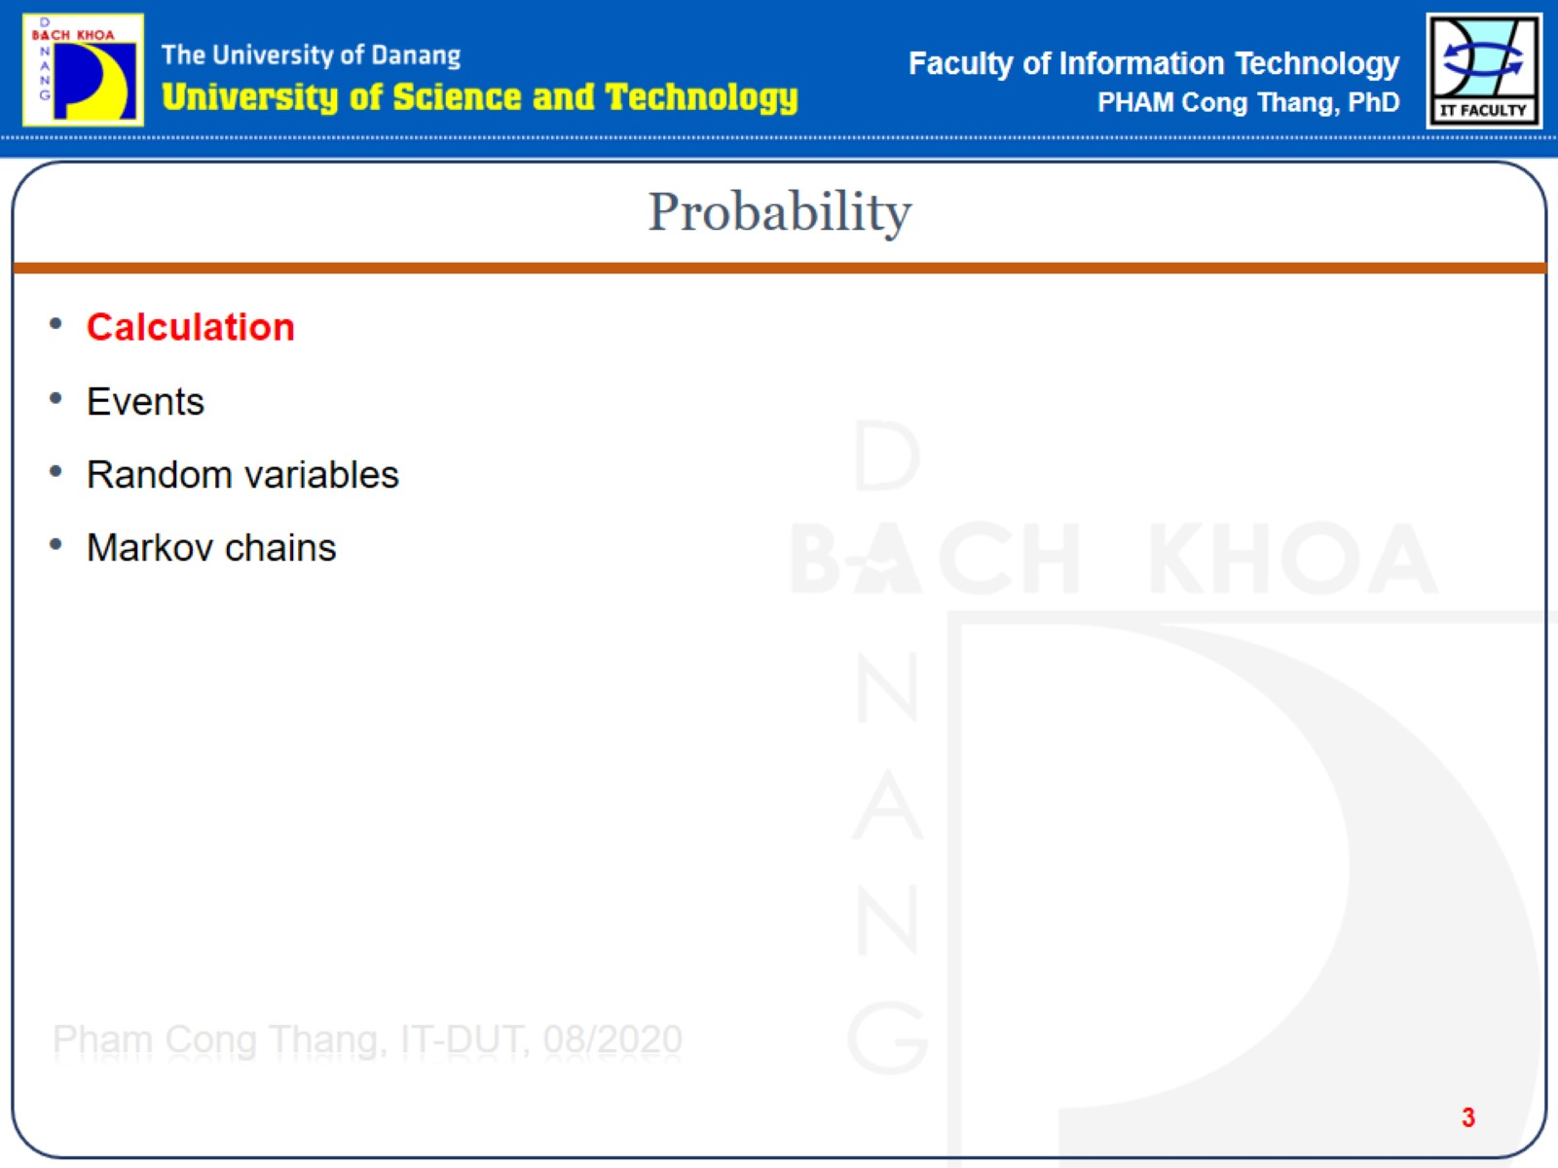
Probability

Slide 4
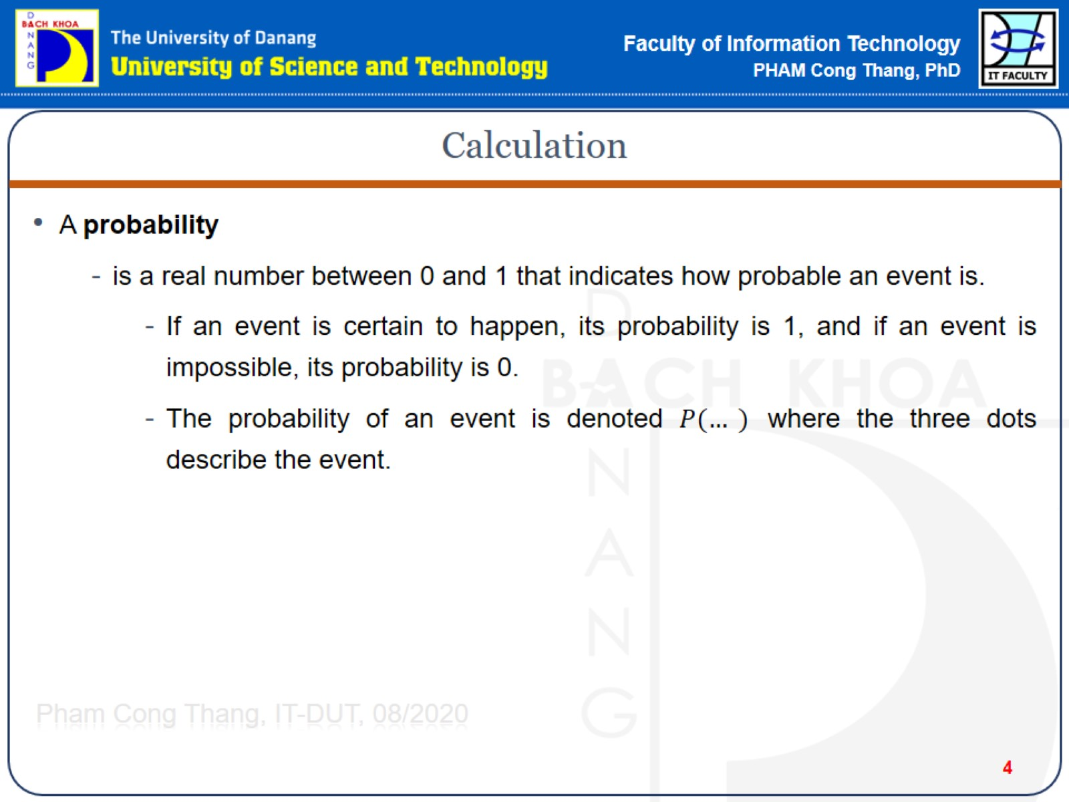
Calculation

Slide 5
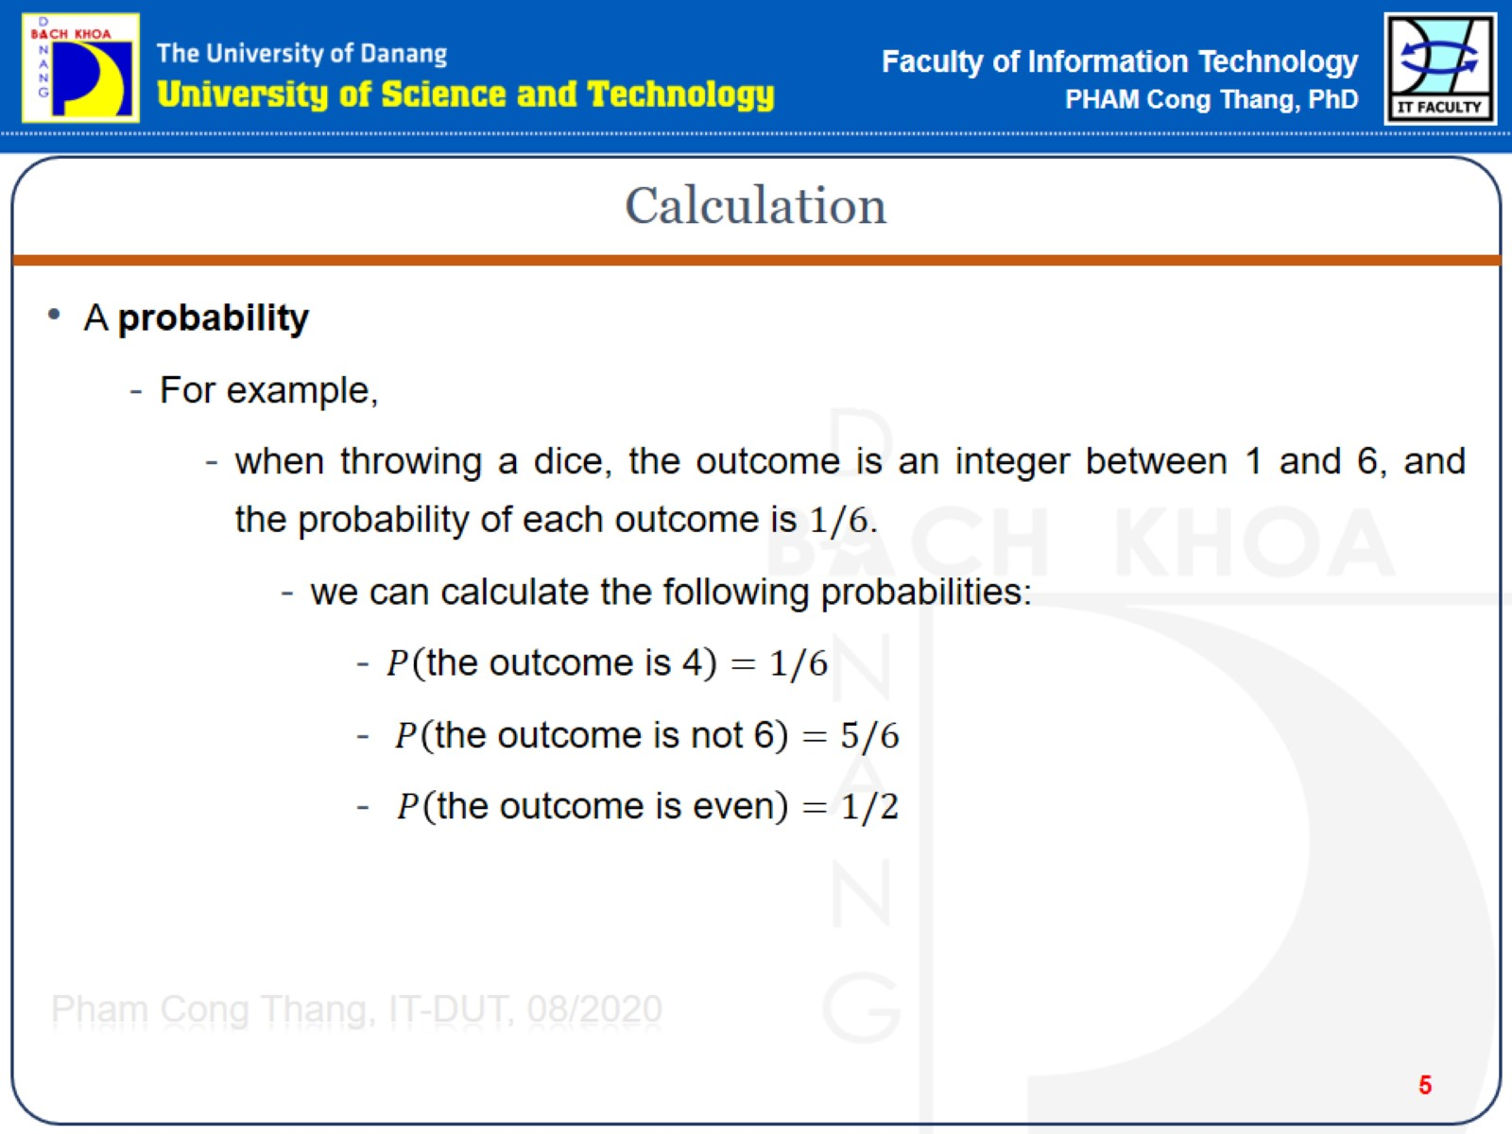
Calculation

Slide 6
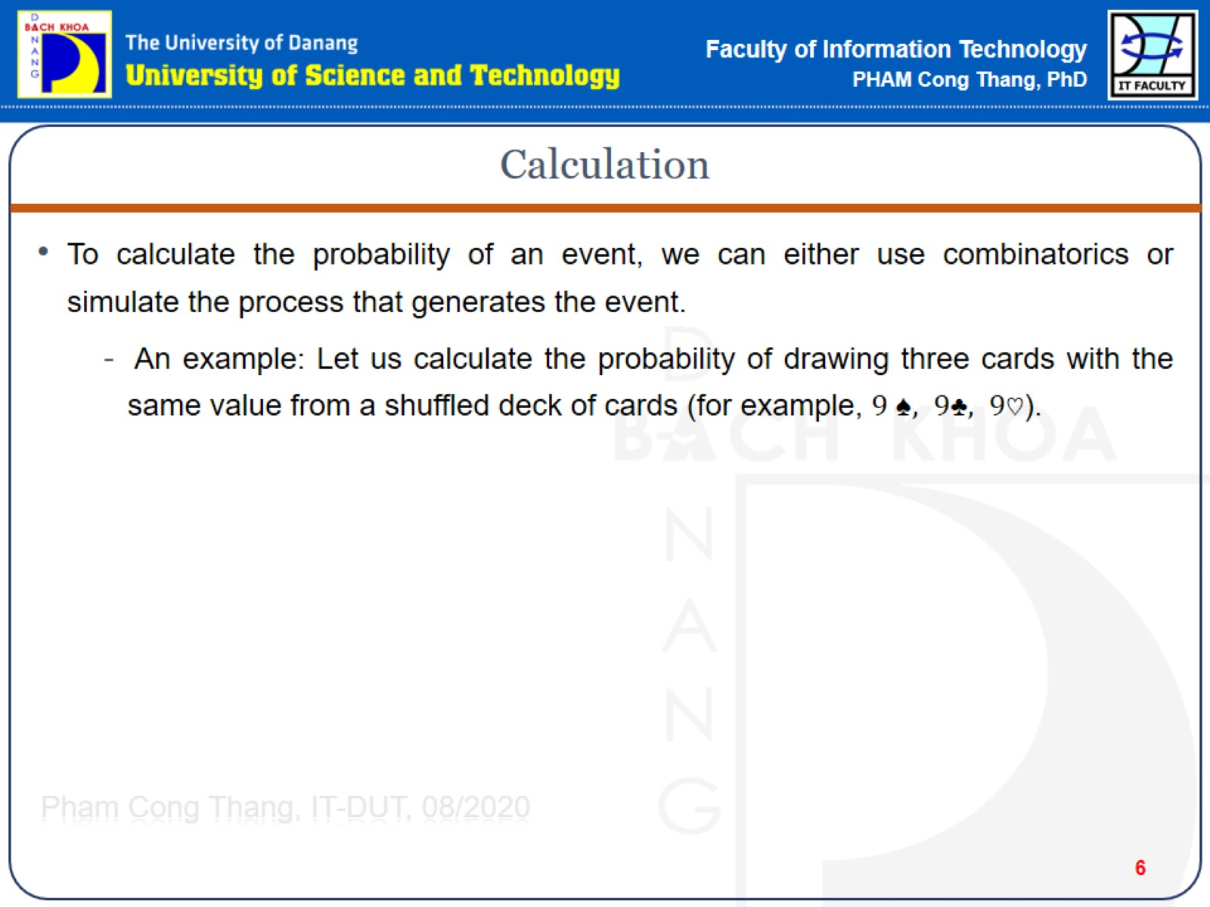
Calculation

Slide 7
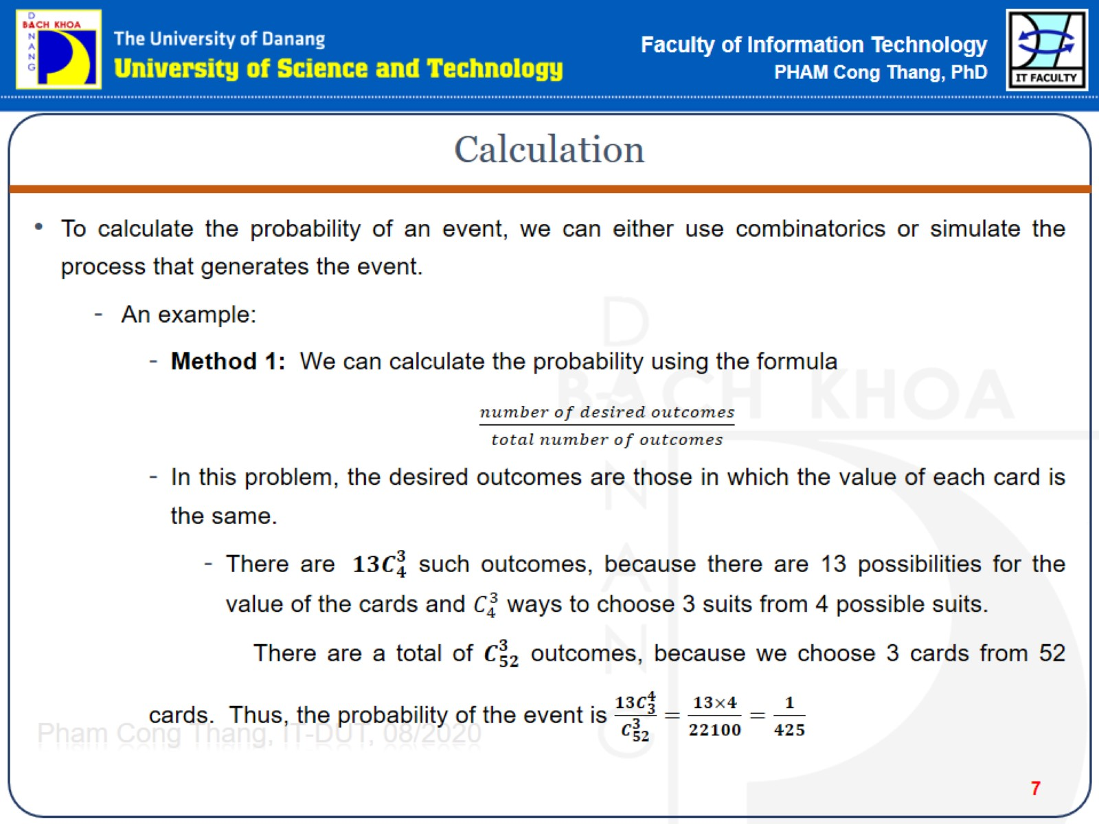
Calculation

Slide 8
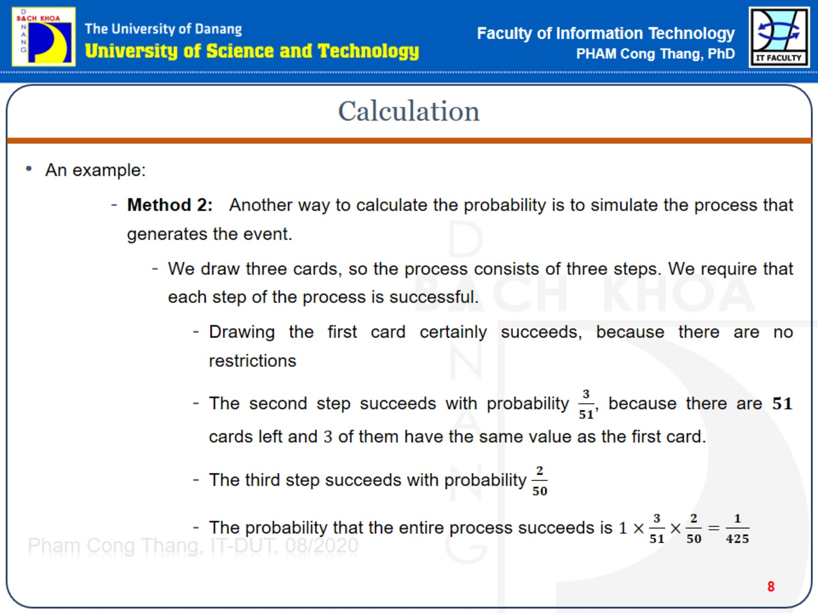
Calculation

Slide 9
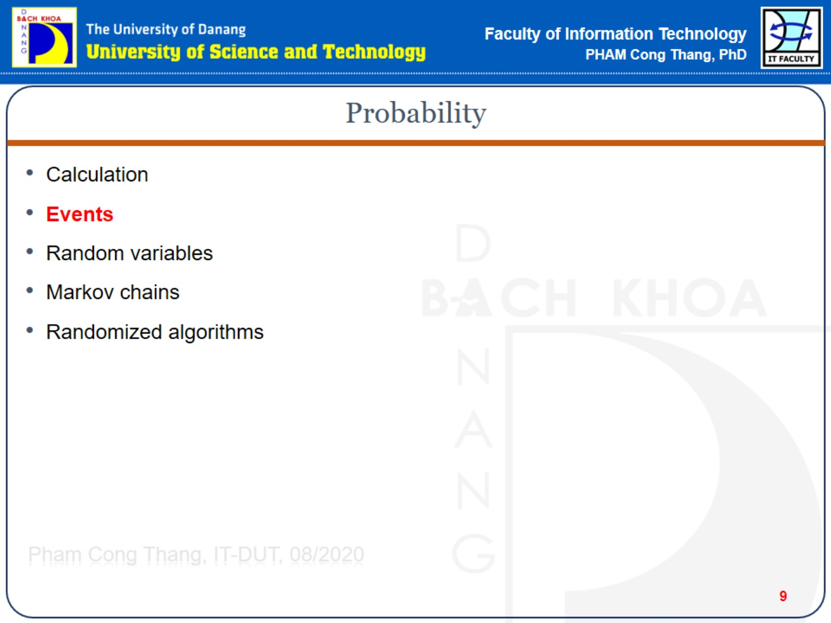
Probability

Slide 10
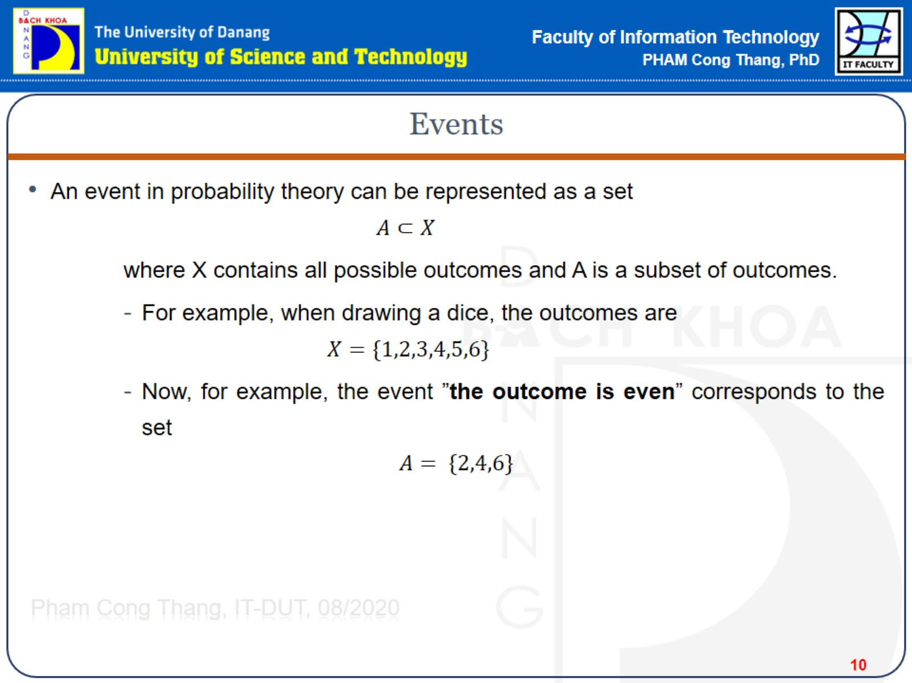
Events

Slide 11
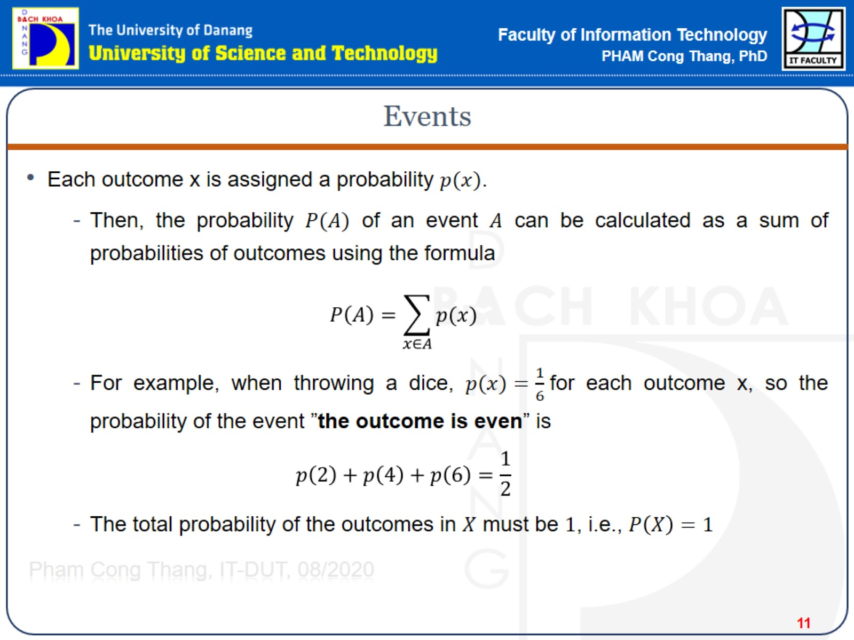
Events

Slide 12
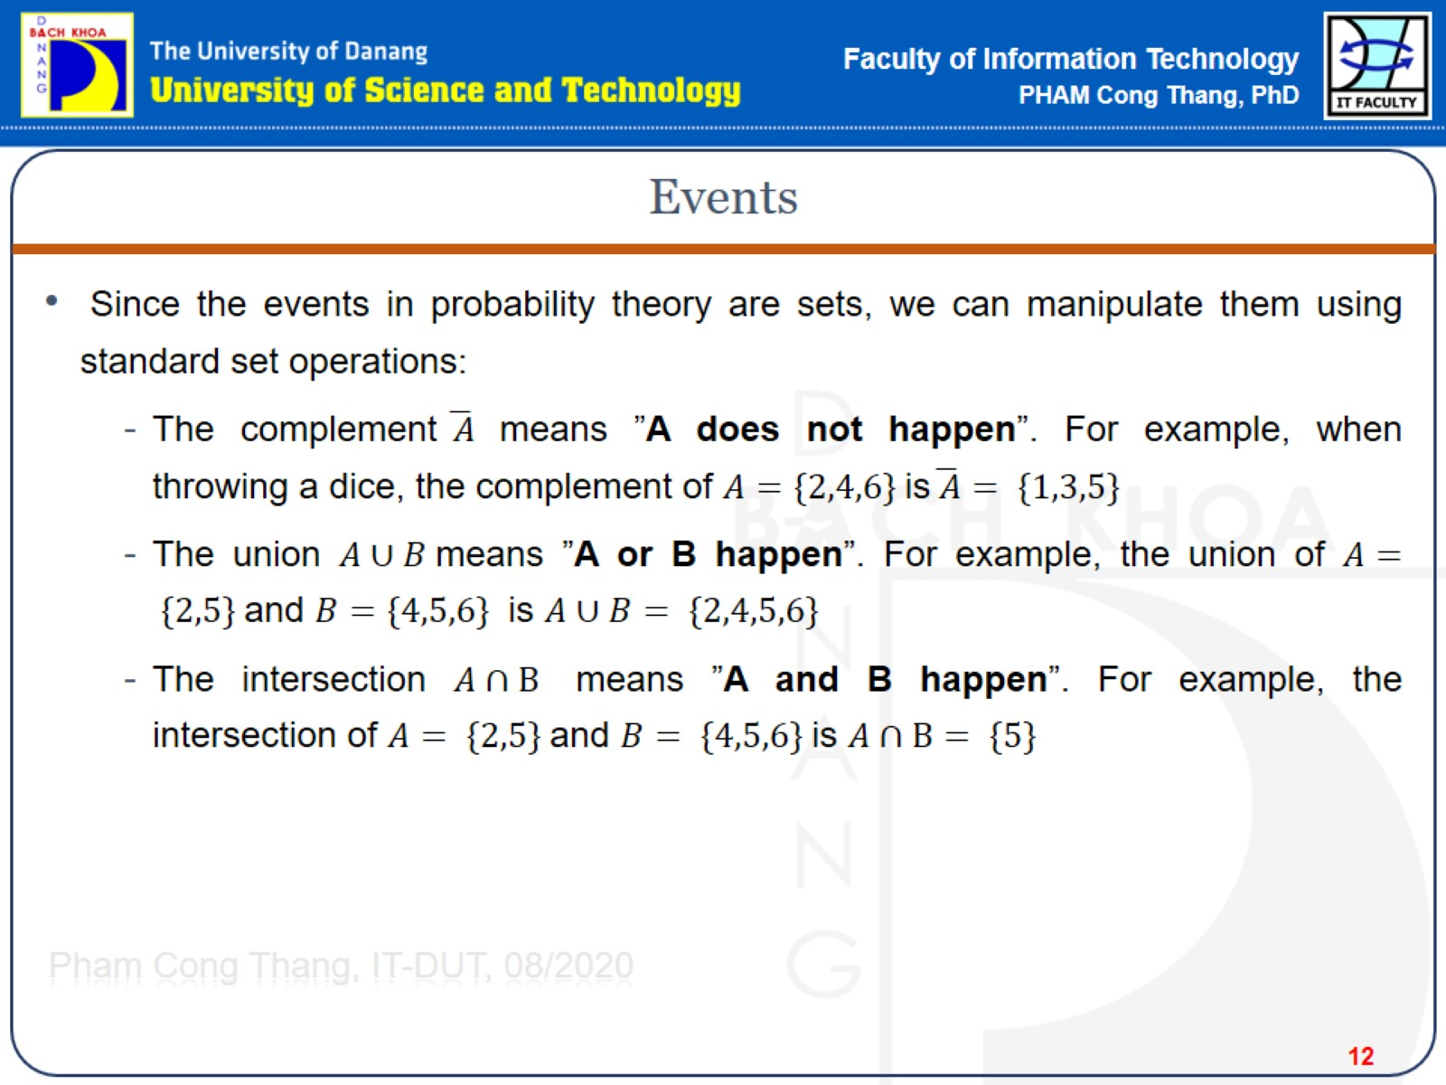
Events

Slide 13
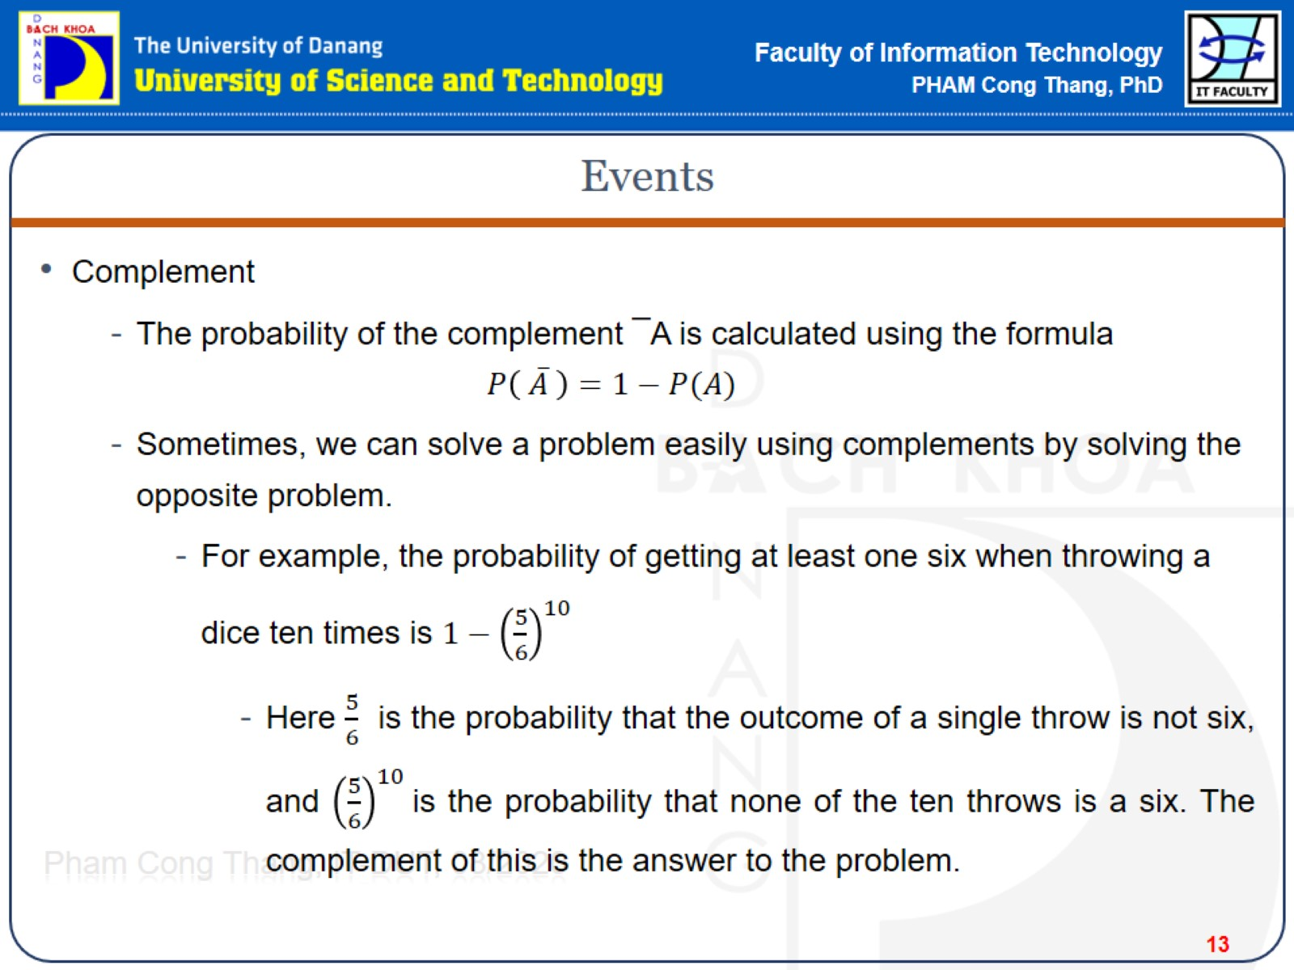
Events

Slide 14
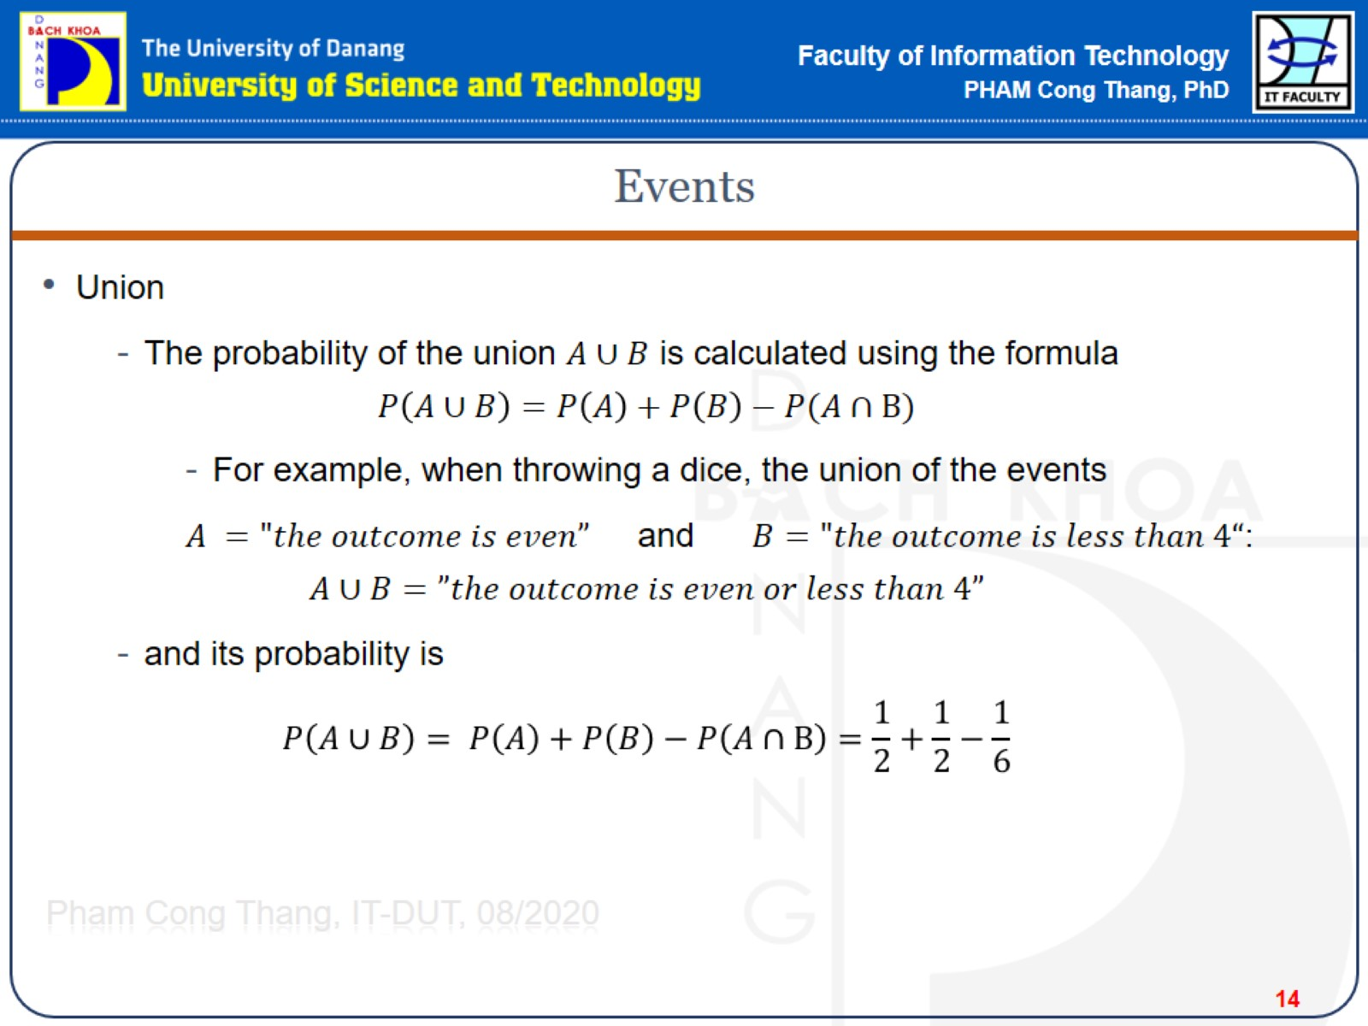
Events

Slide 15
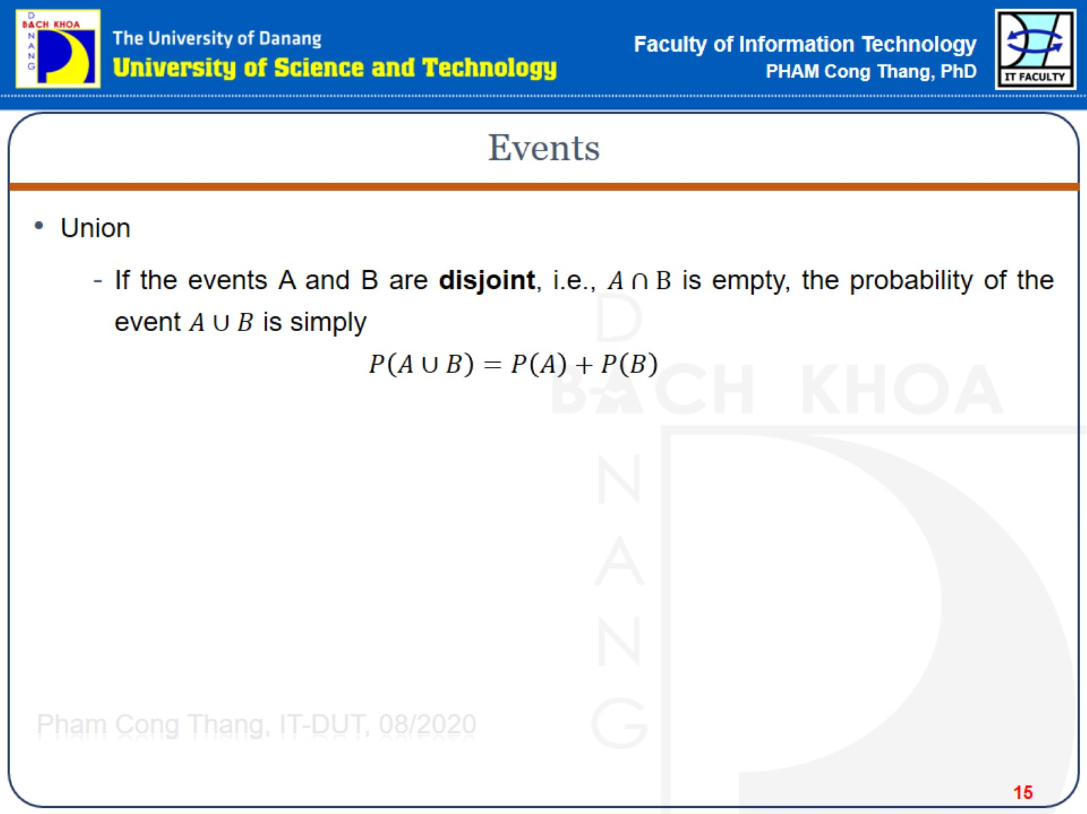
Events

Slide 16
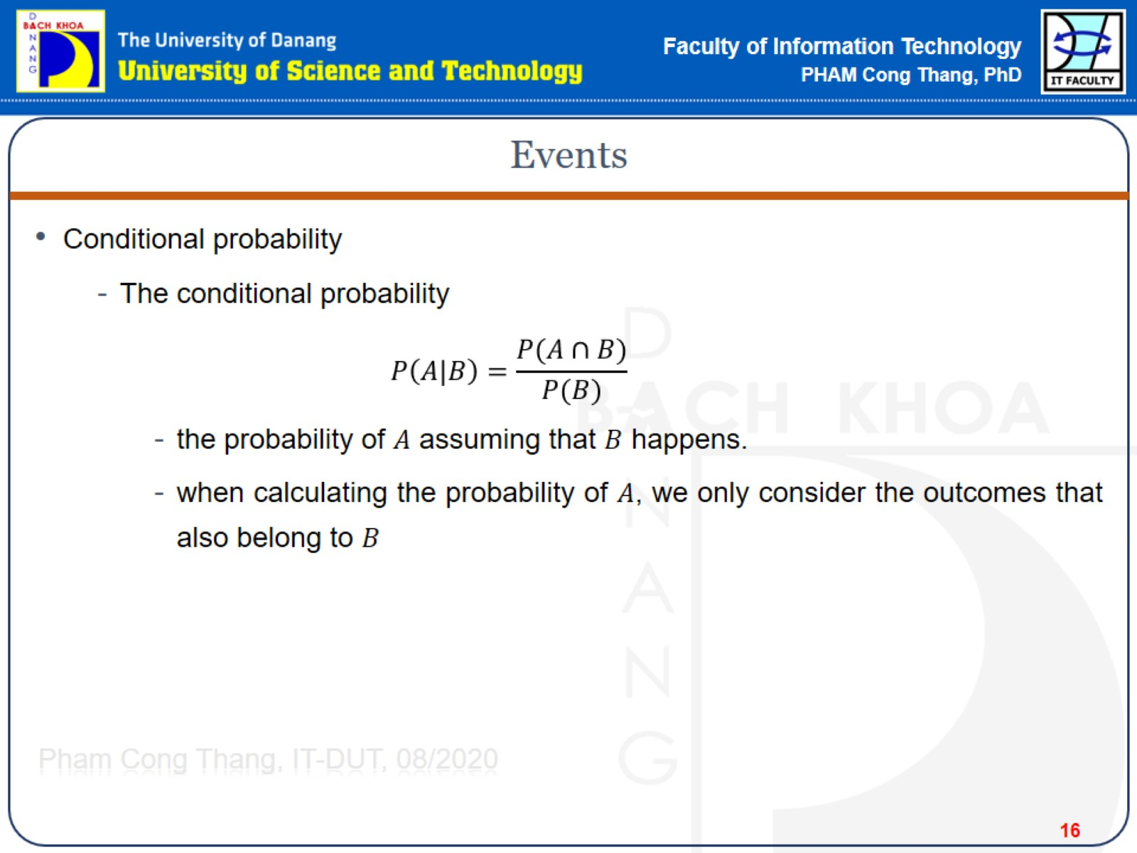
Events

Slide 17
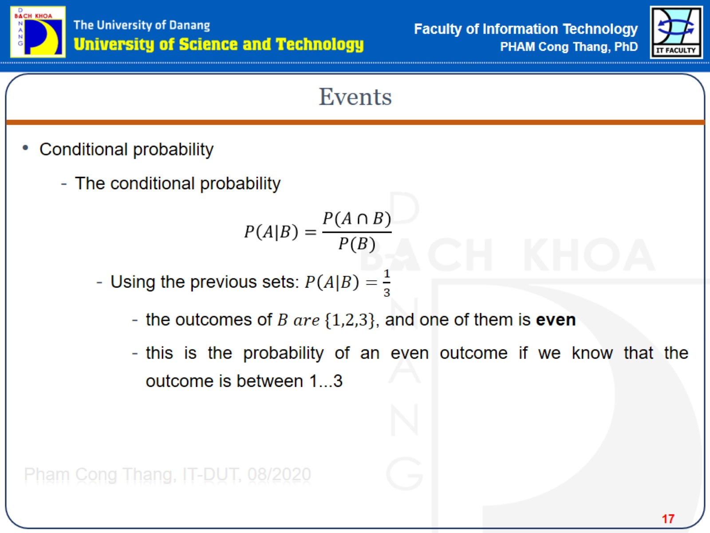
Events

Slide 18
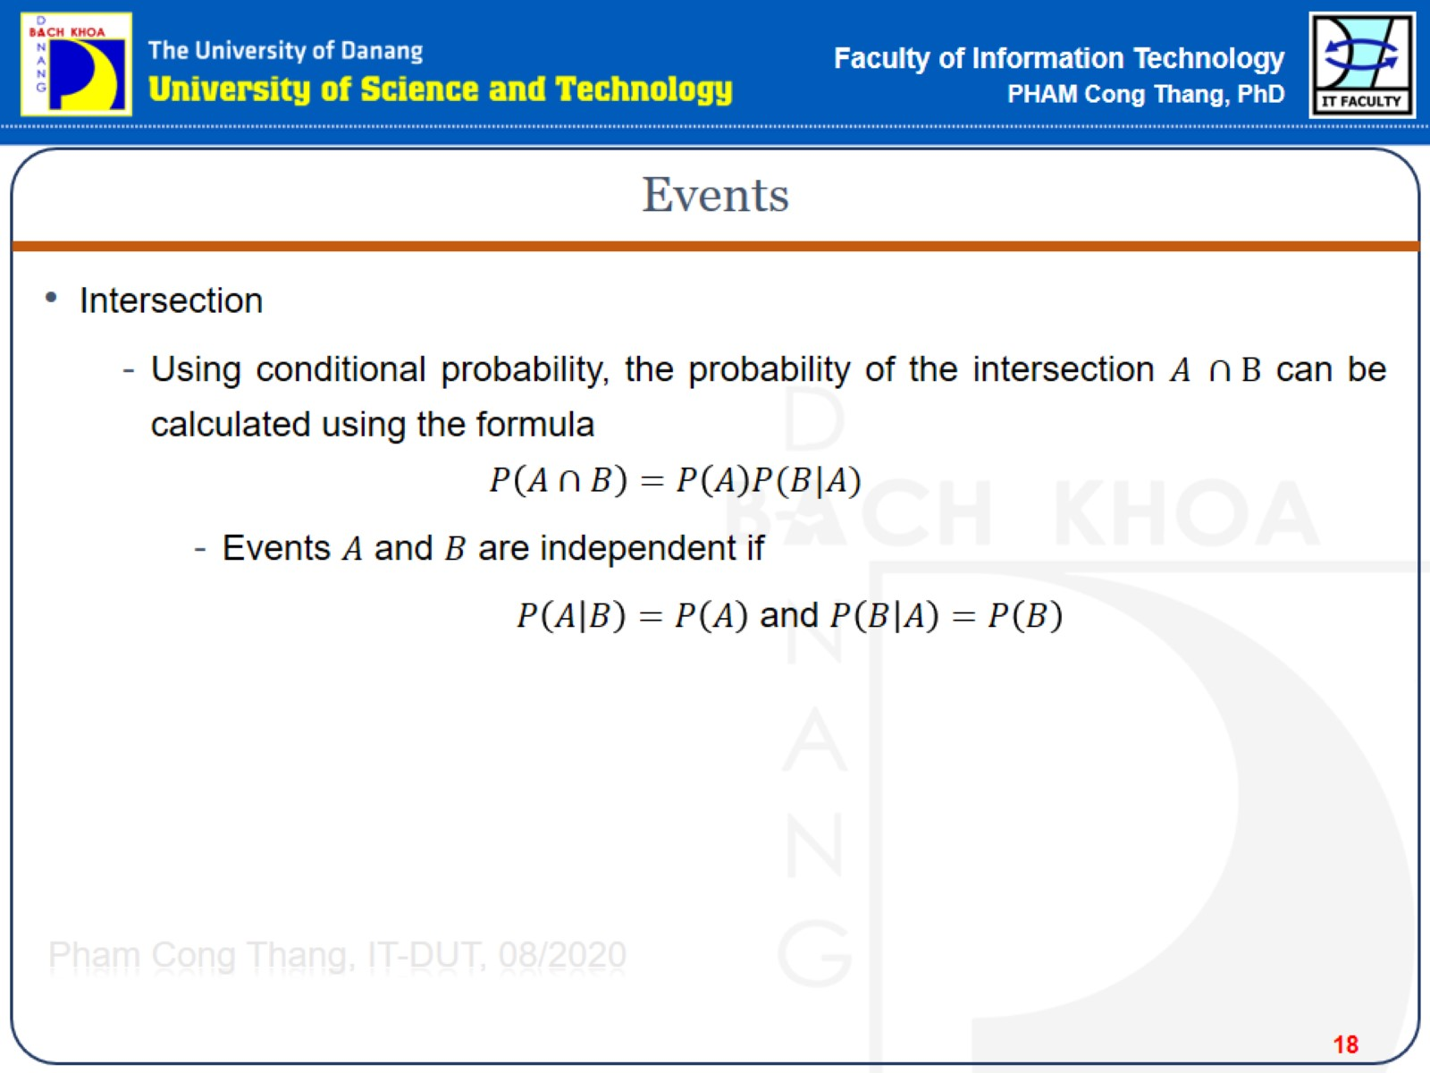
Events

Slide 19
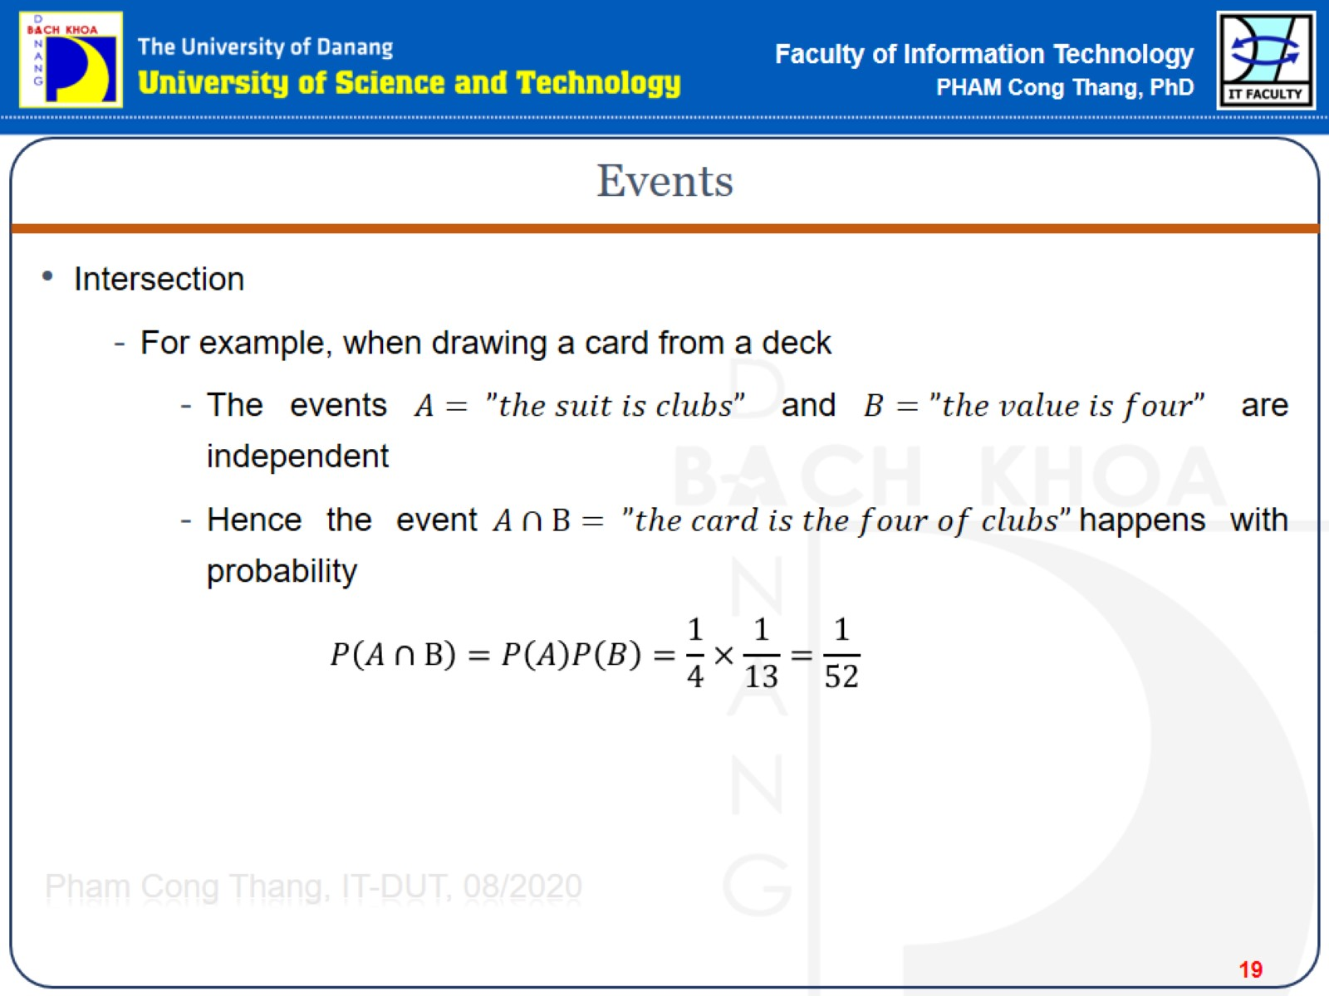
Events

Slide 20
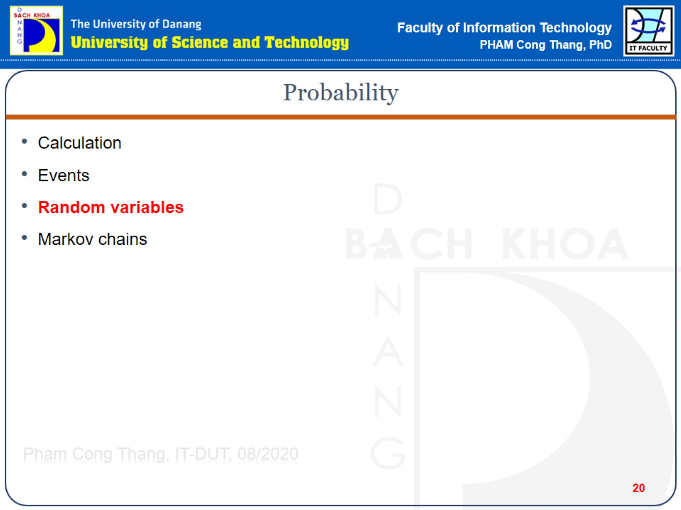
Probability

Slide 21
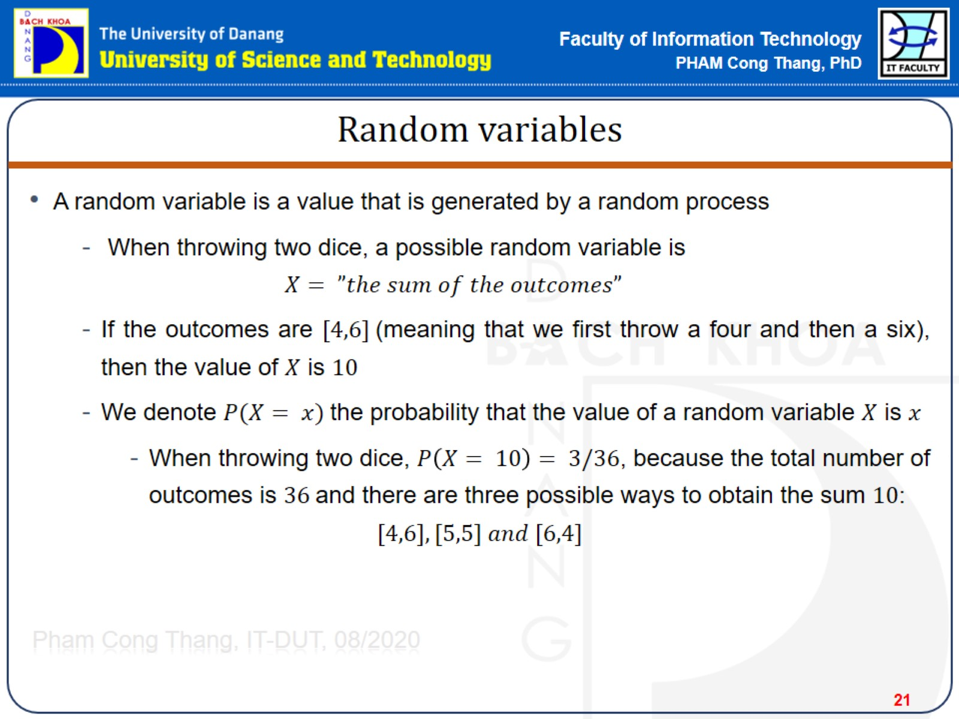
Random variables

Slide 22
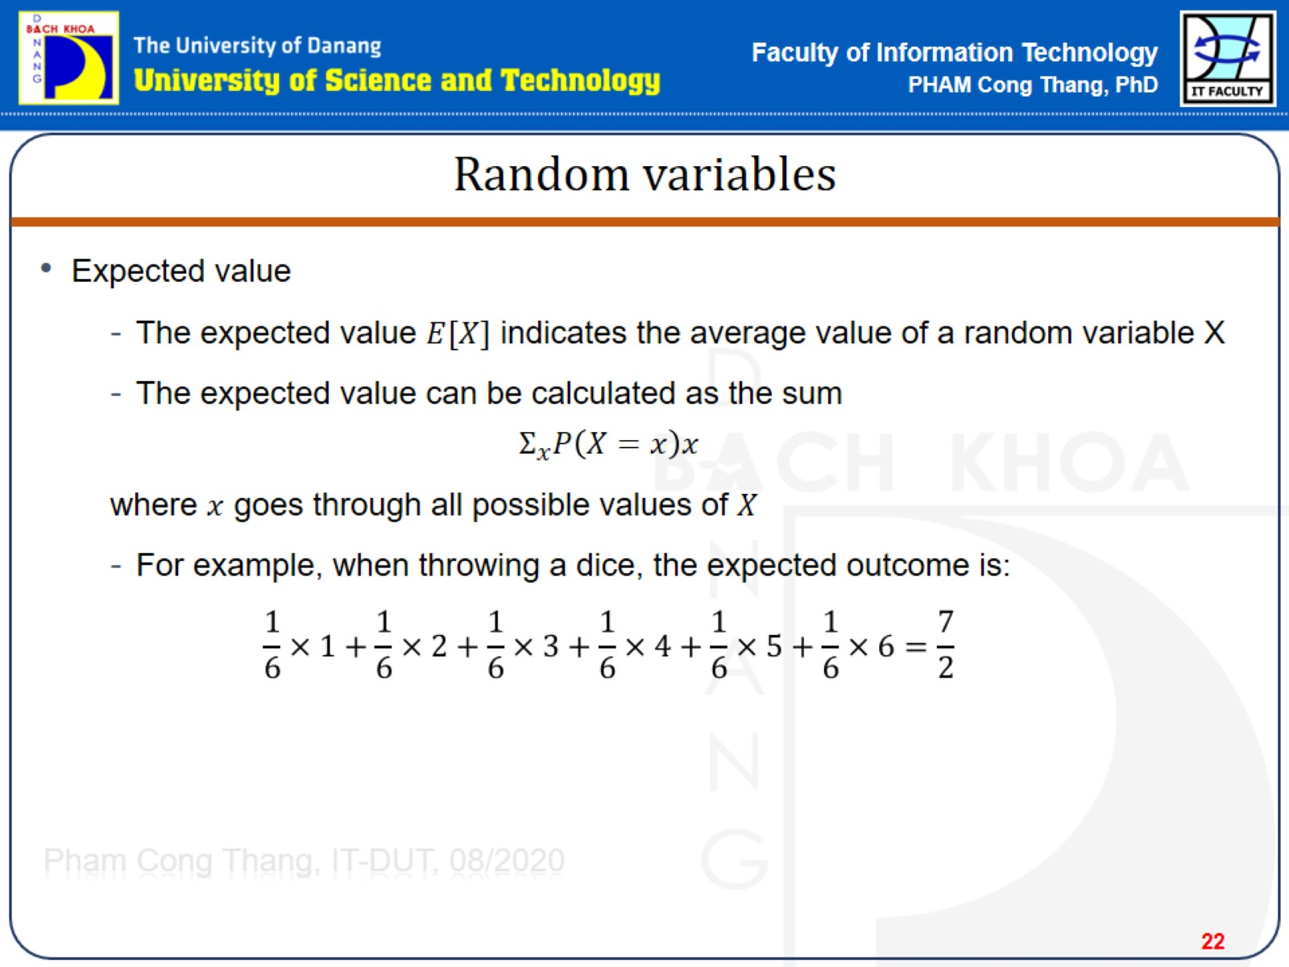
Random variables

Slide 23
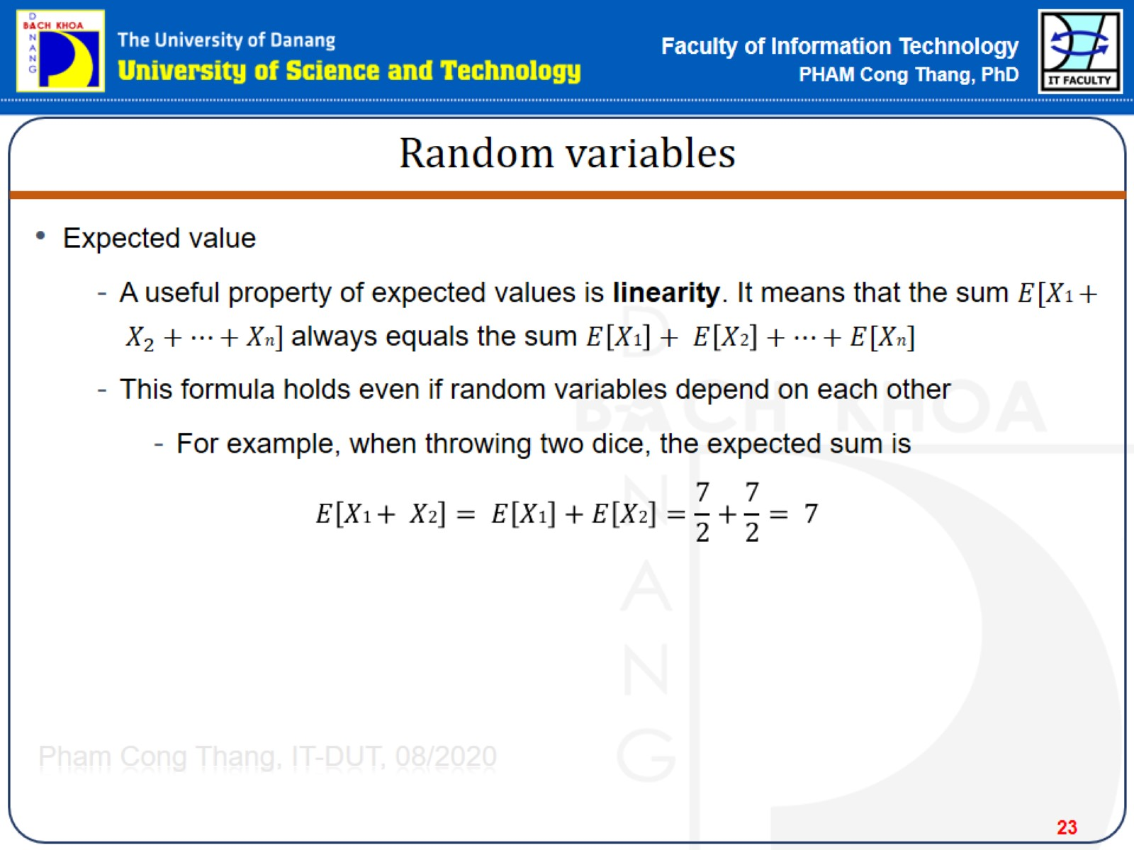
Random variables

Slide 24
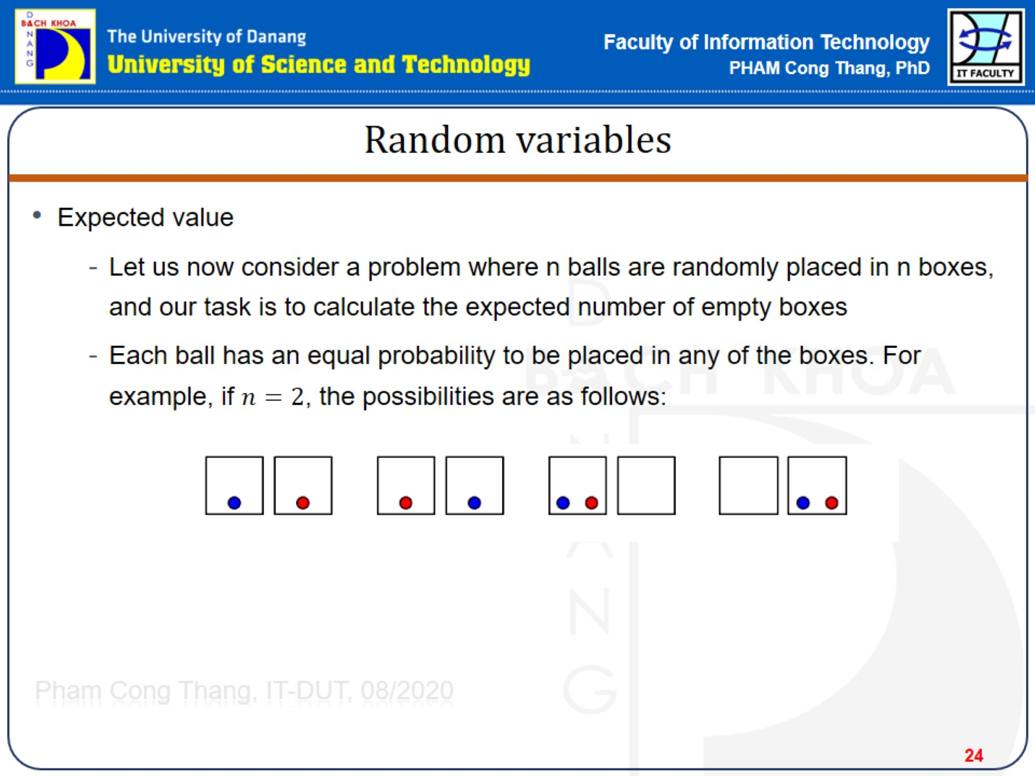
Random variables

Slide 25
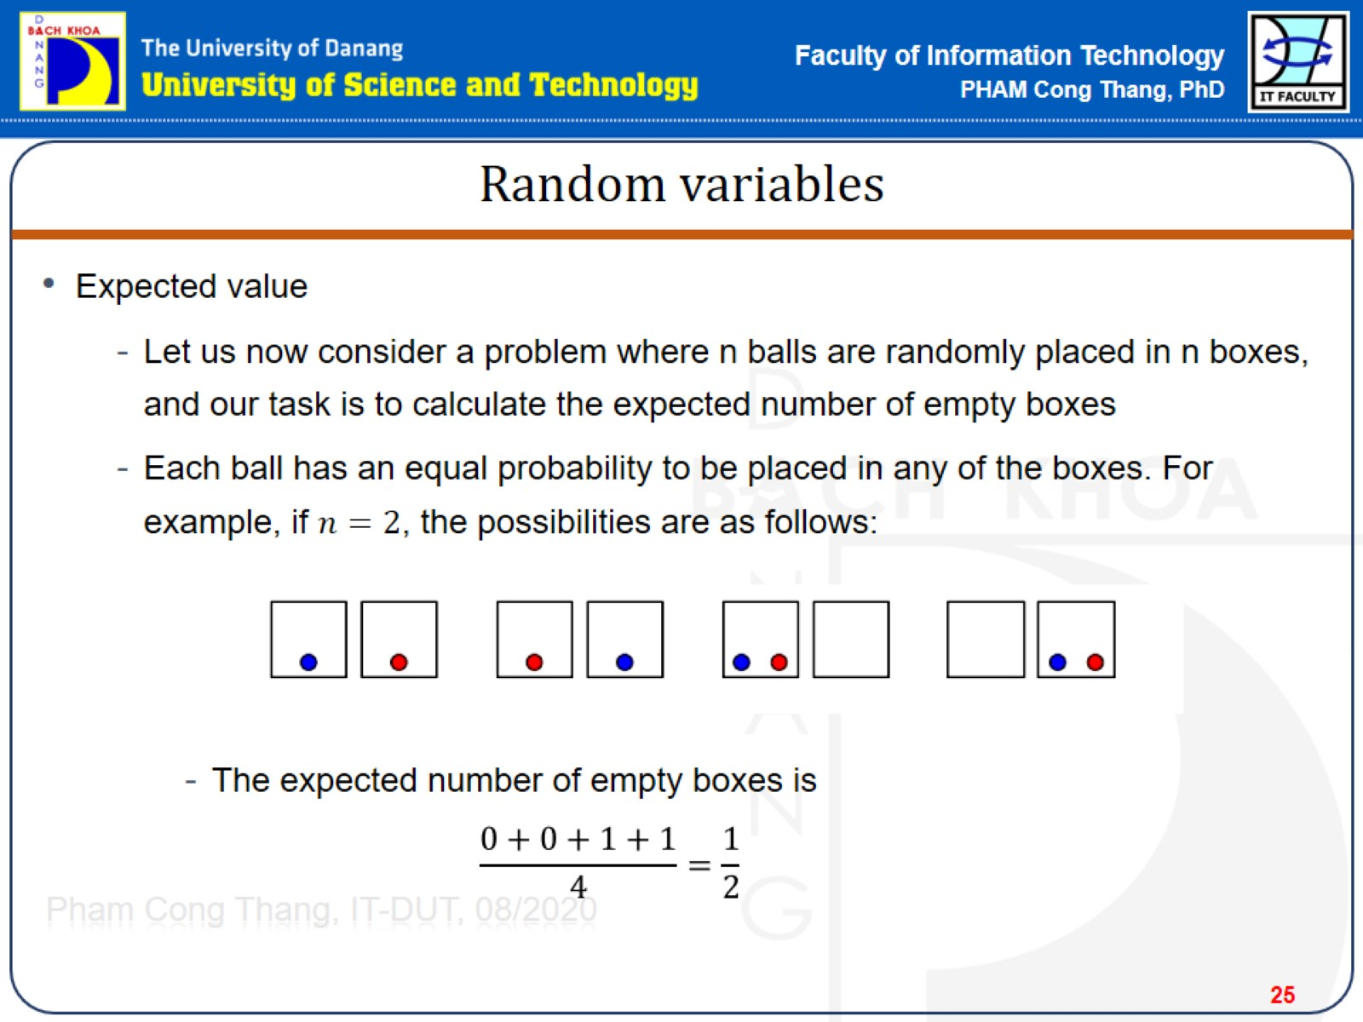
Random variables

Slide 26
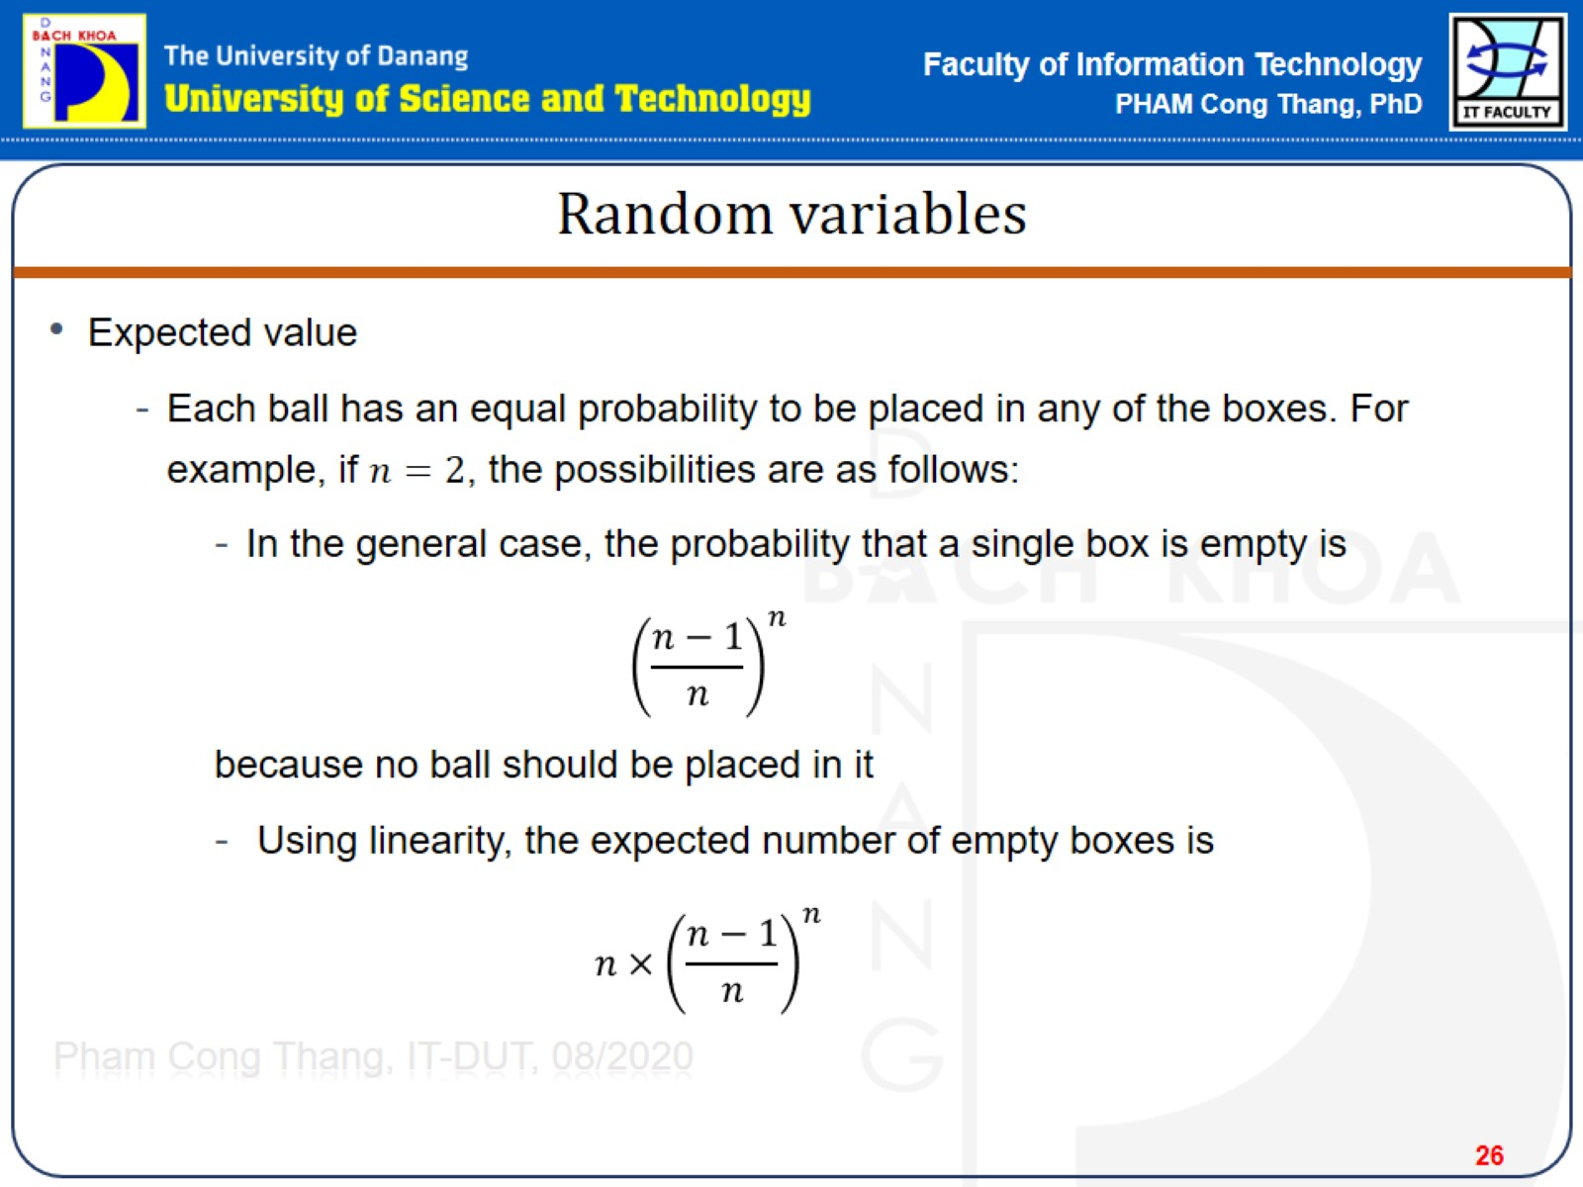
Random variables

Slide 27
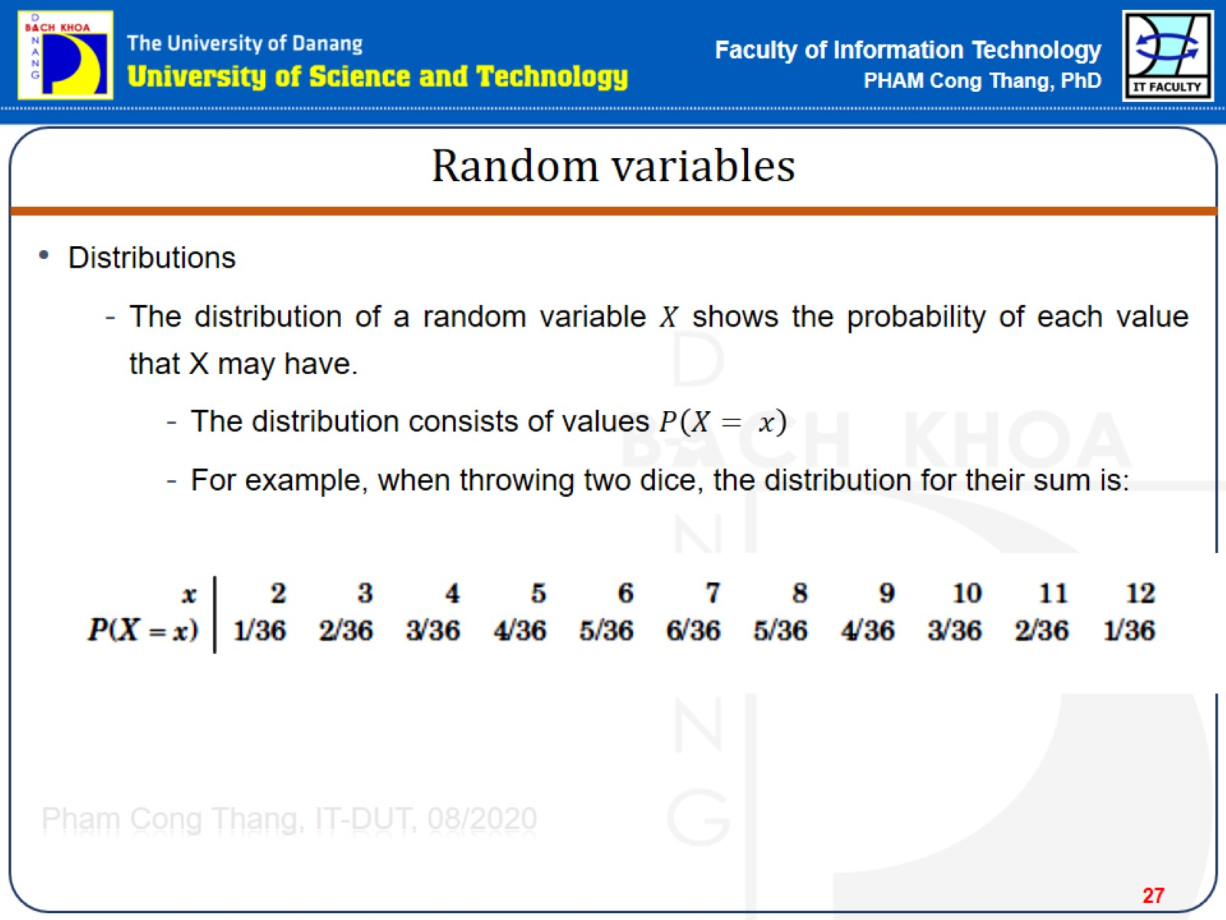
Random variables

Slide 28
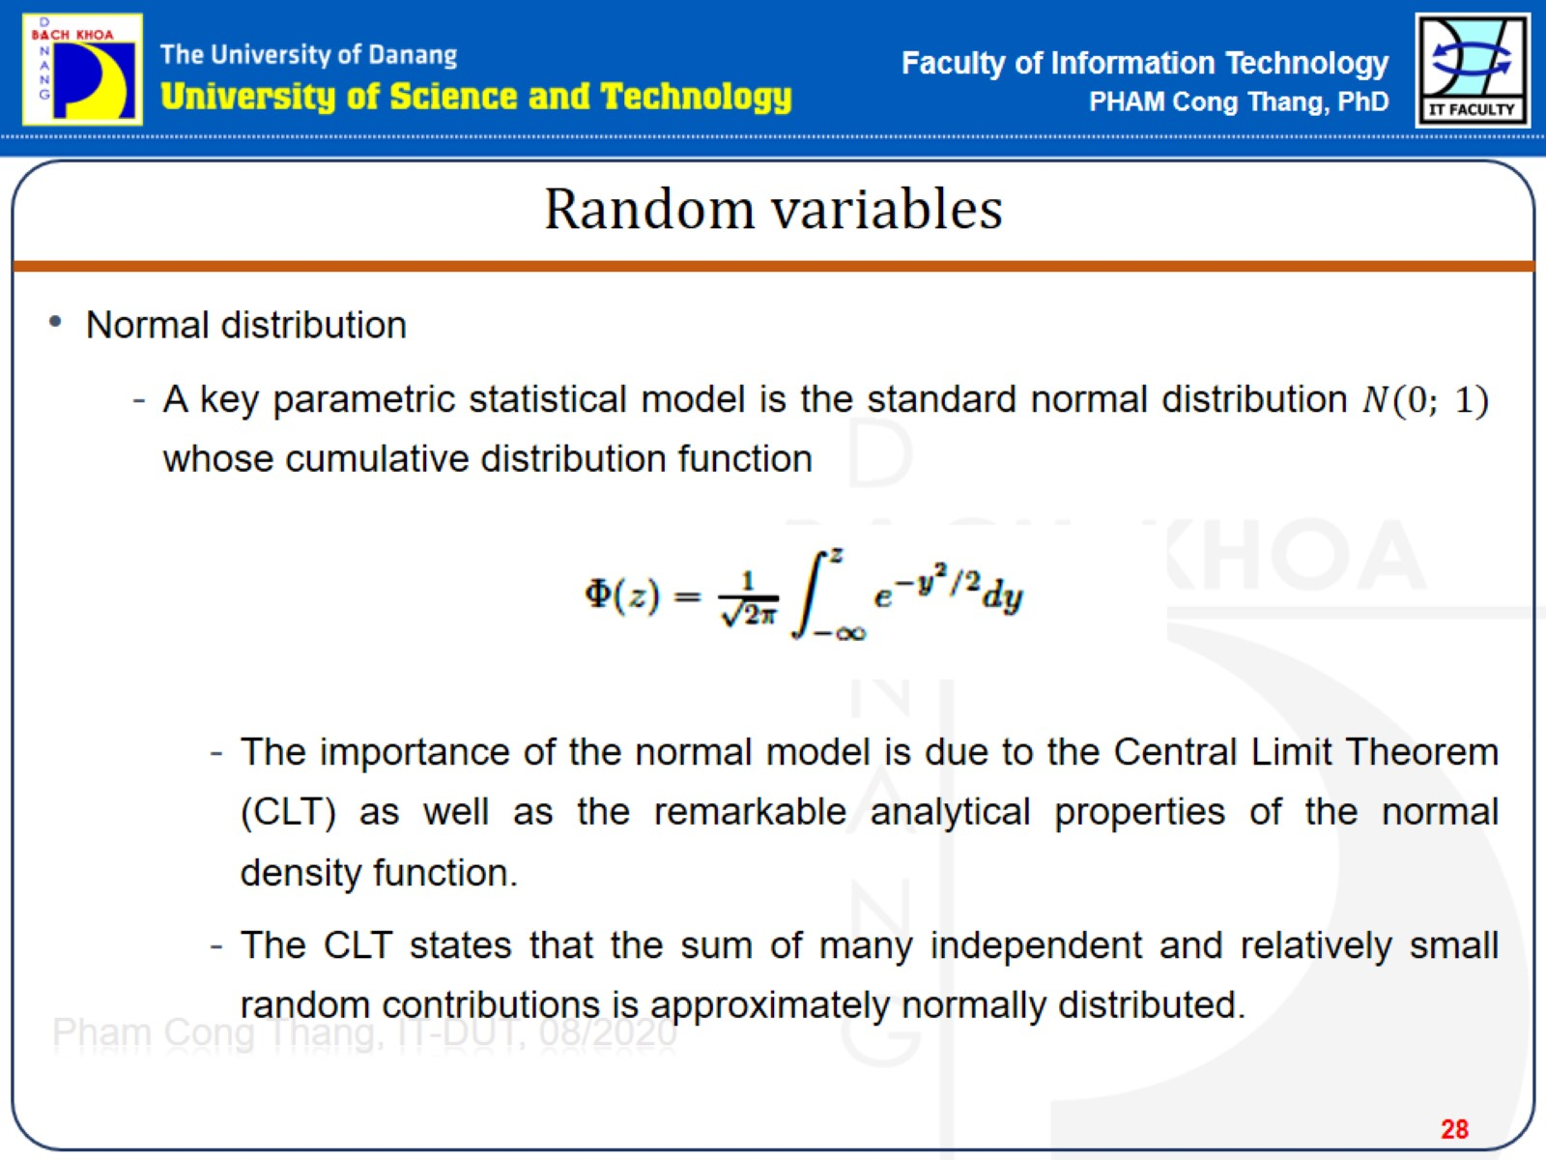
Random variables

Slide 29
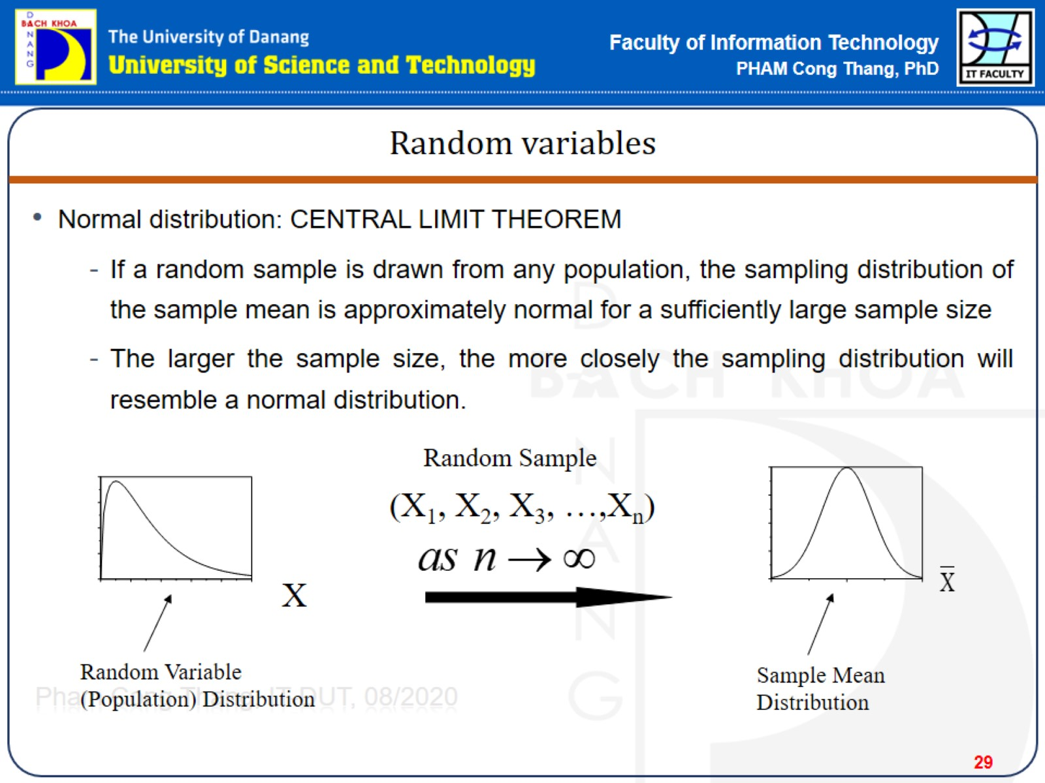
Random variables

Slide 30
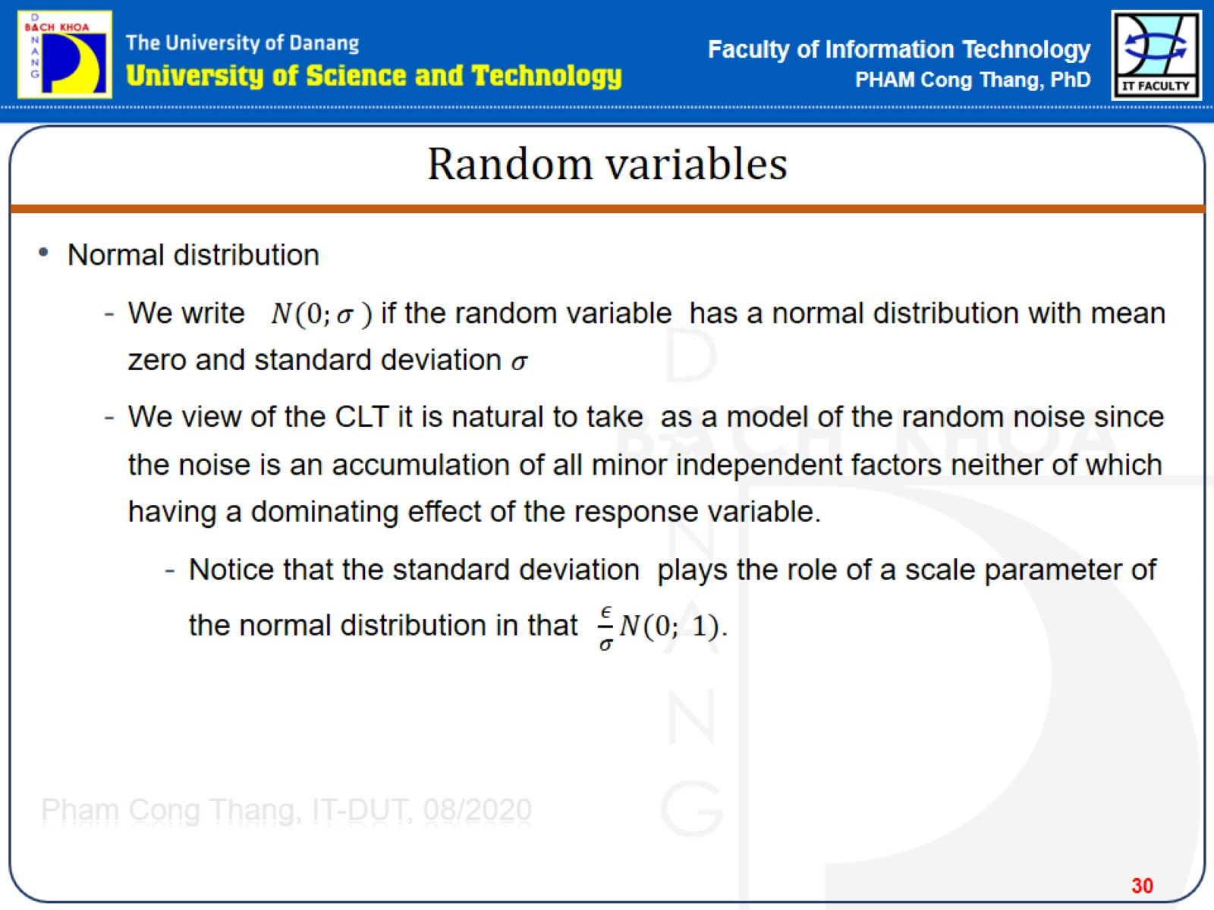
Random variables

Slide 31
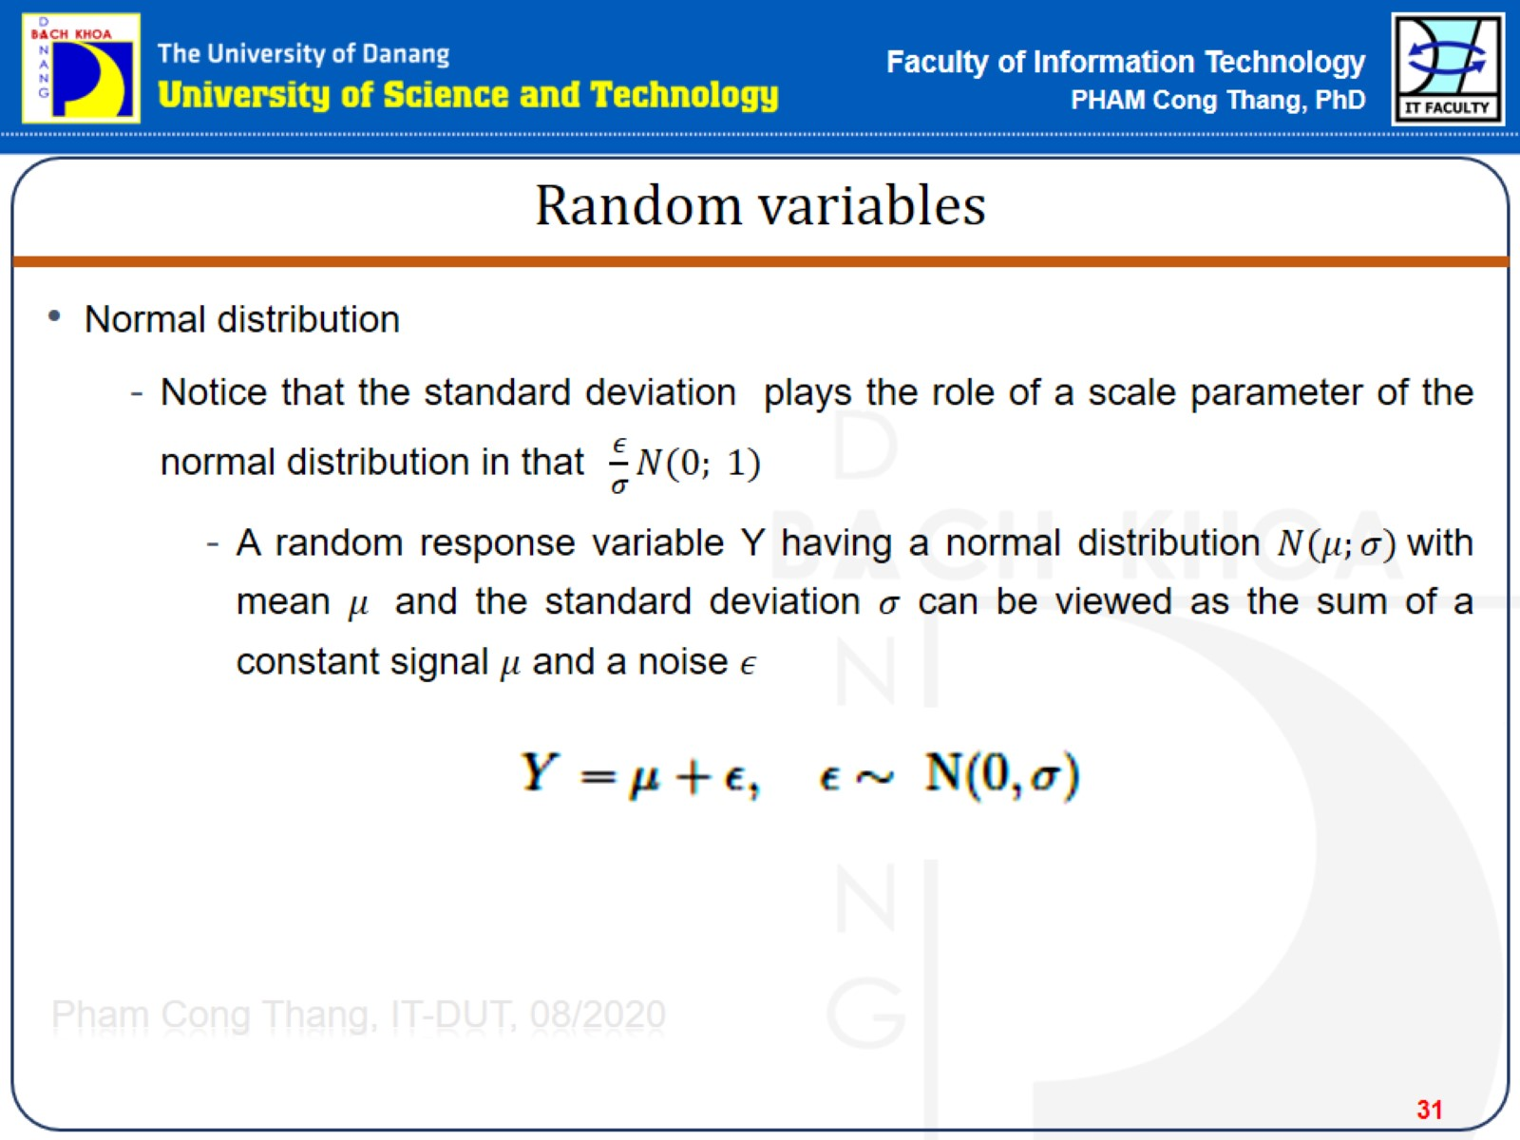
Random variables

Slide 32
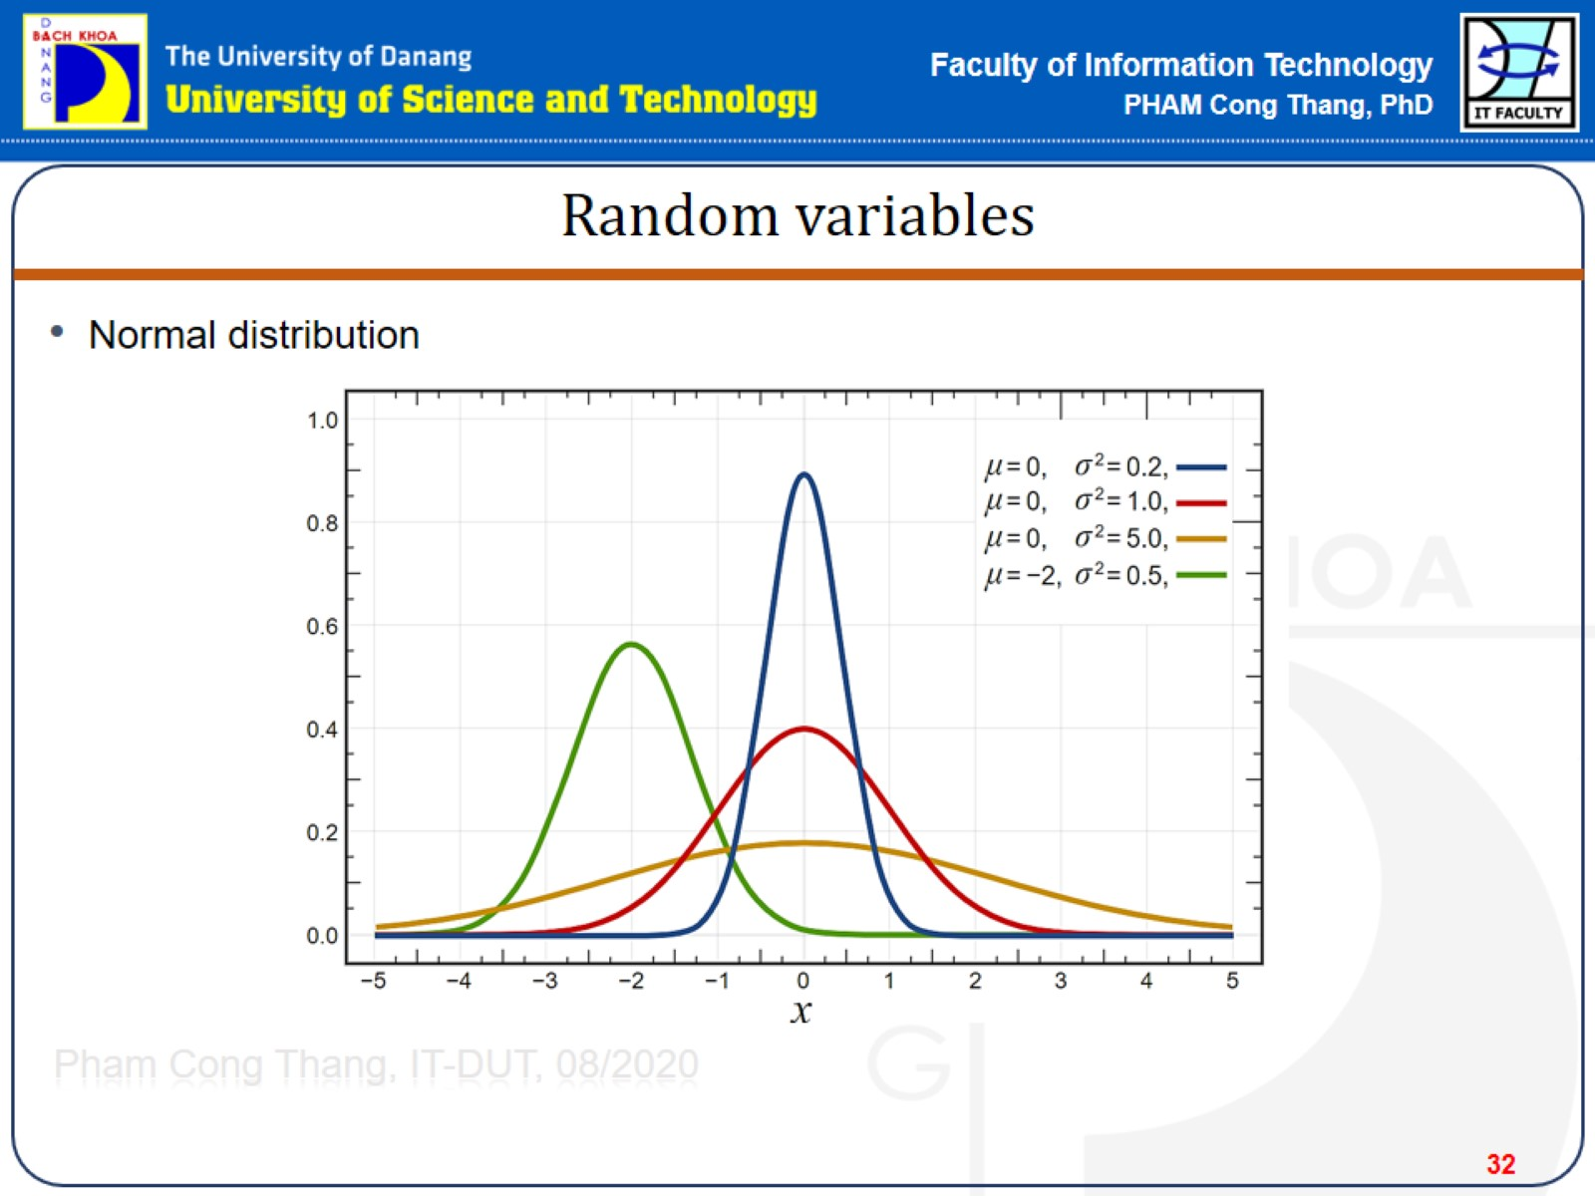
Random variables

Slide 33
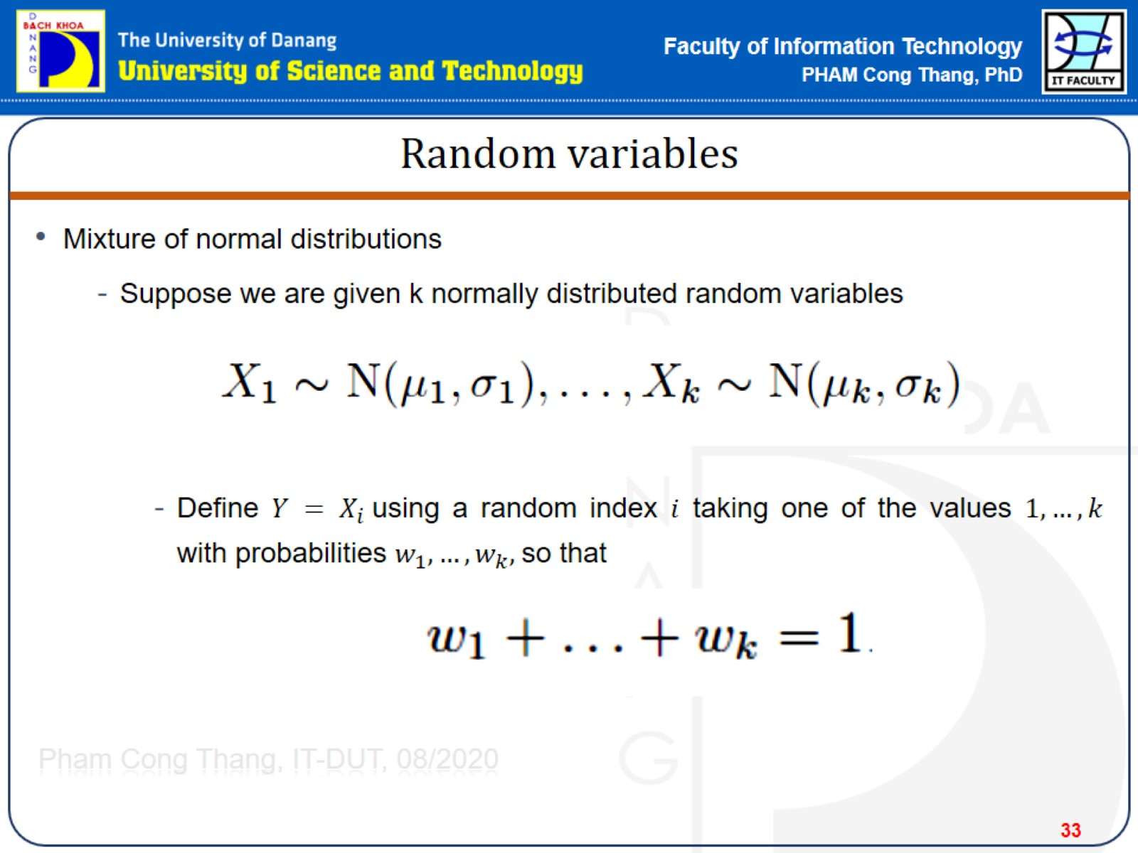
Random variables

Slide 34
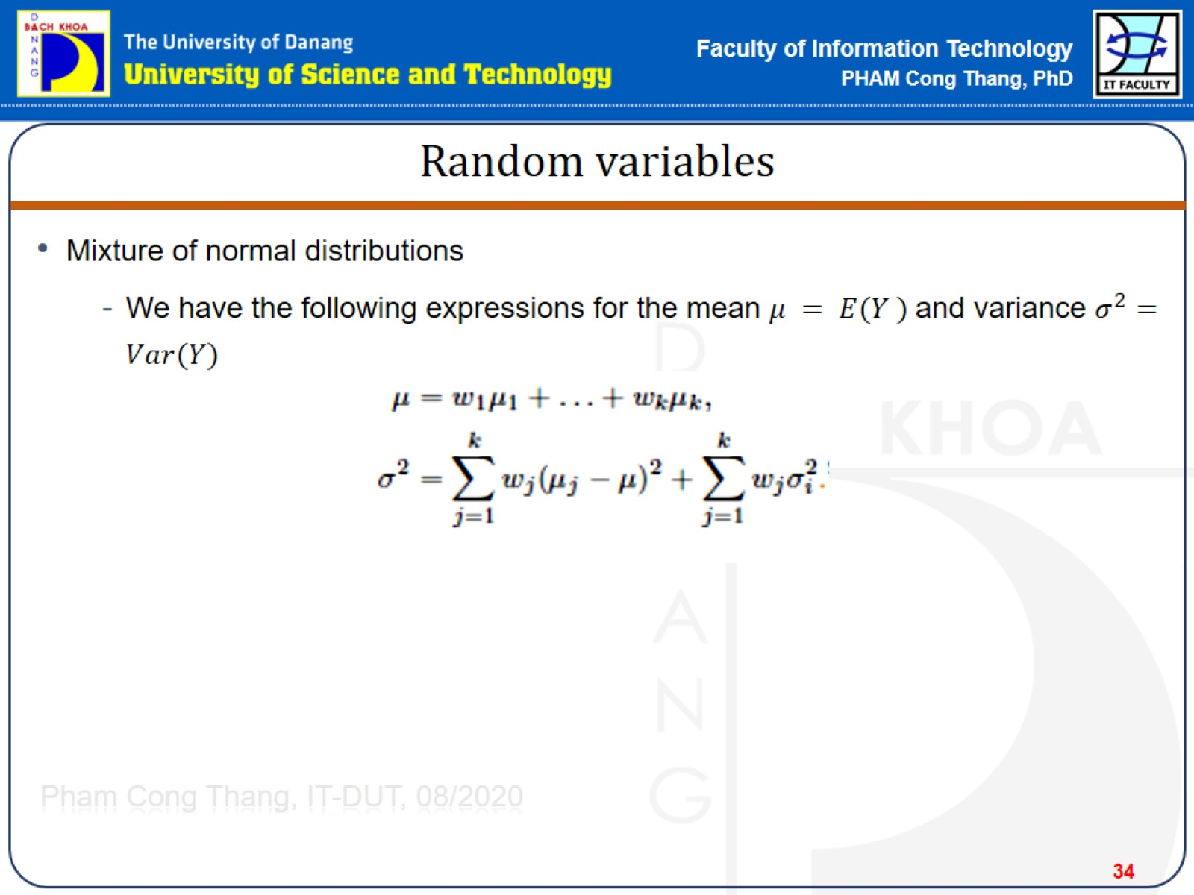
Random variables

Slide 35
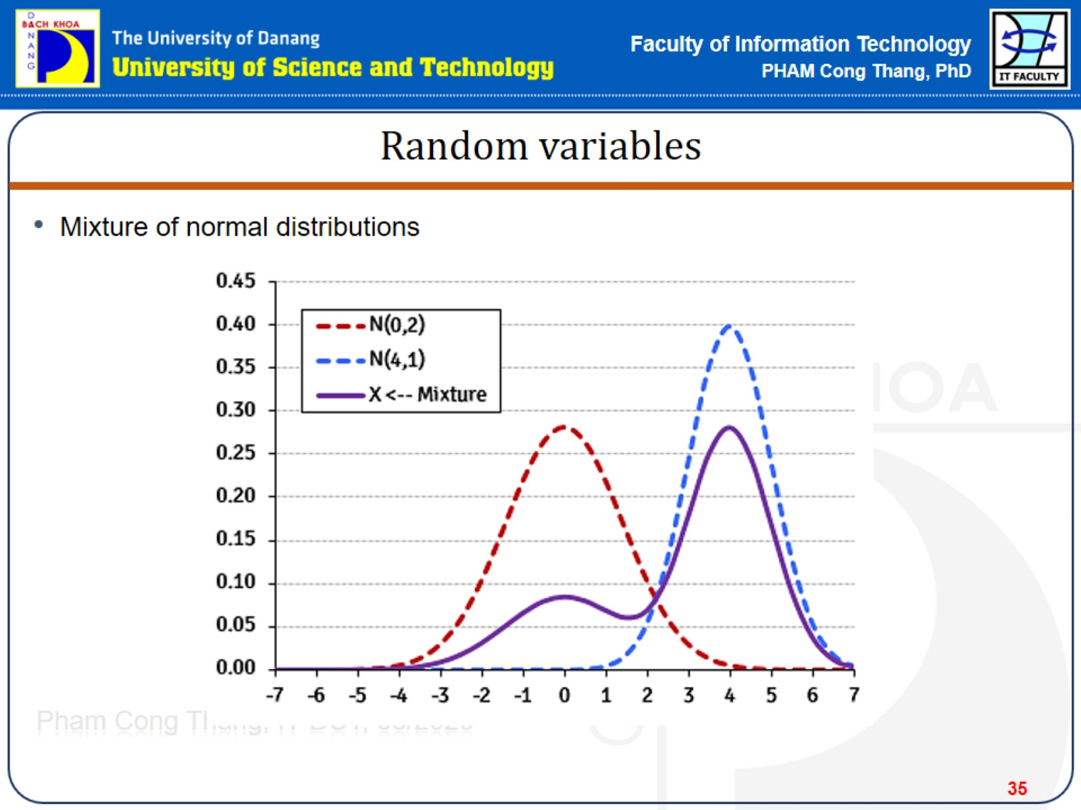
Random variables

Slide 36
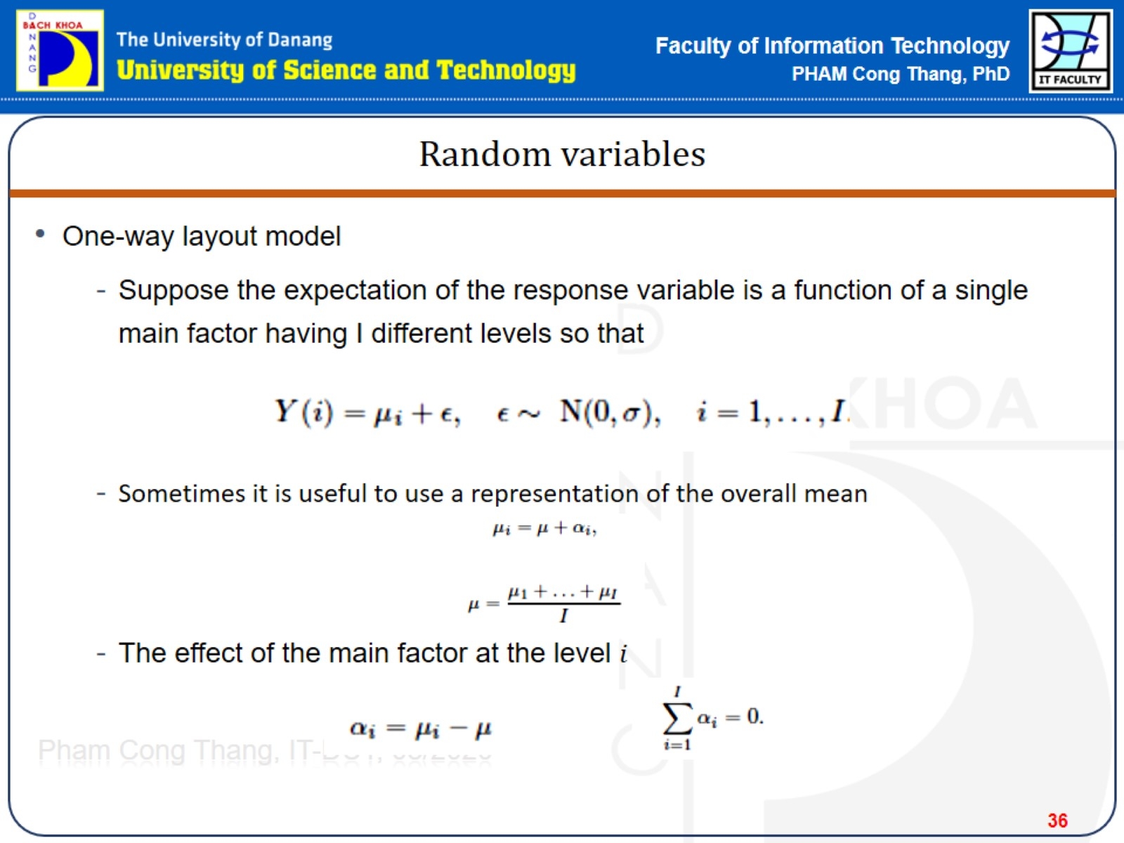
Random variables

Slide 37
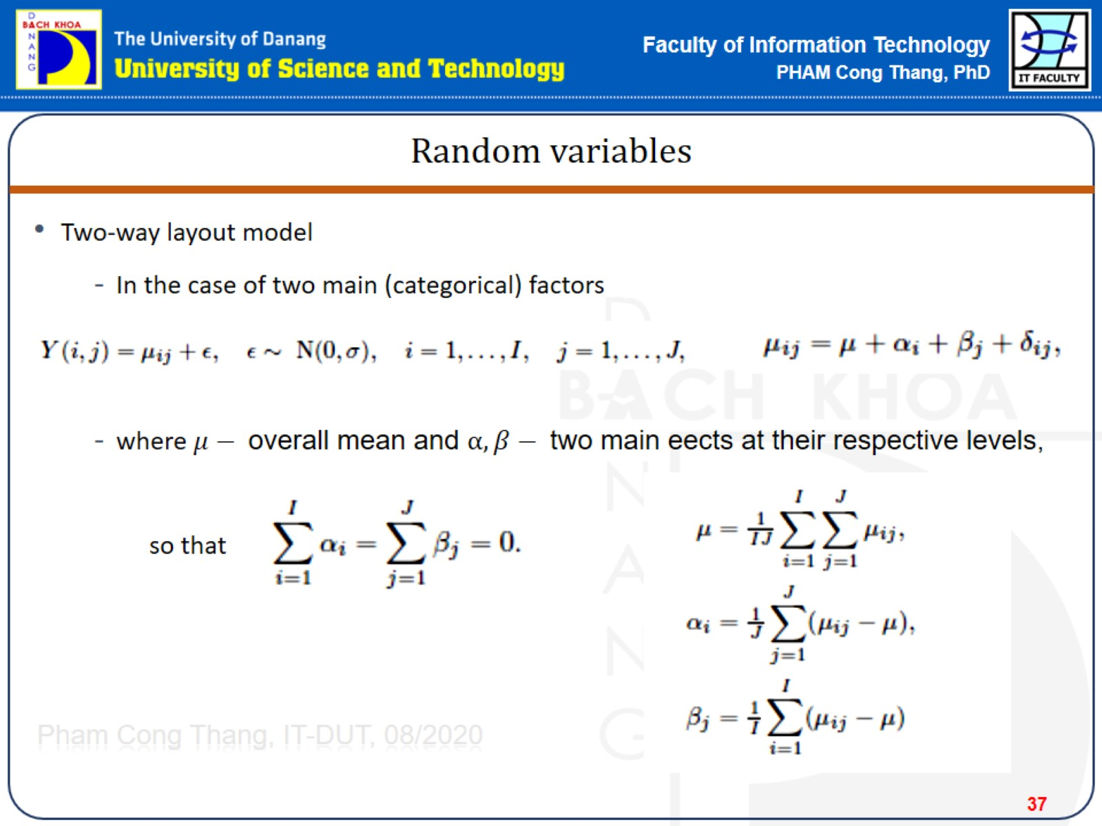
Random variables

Slide 38
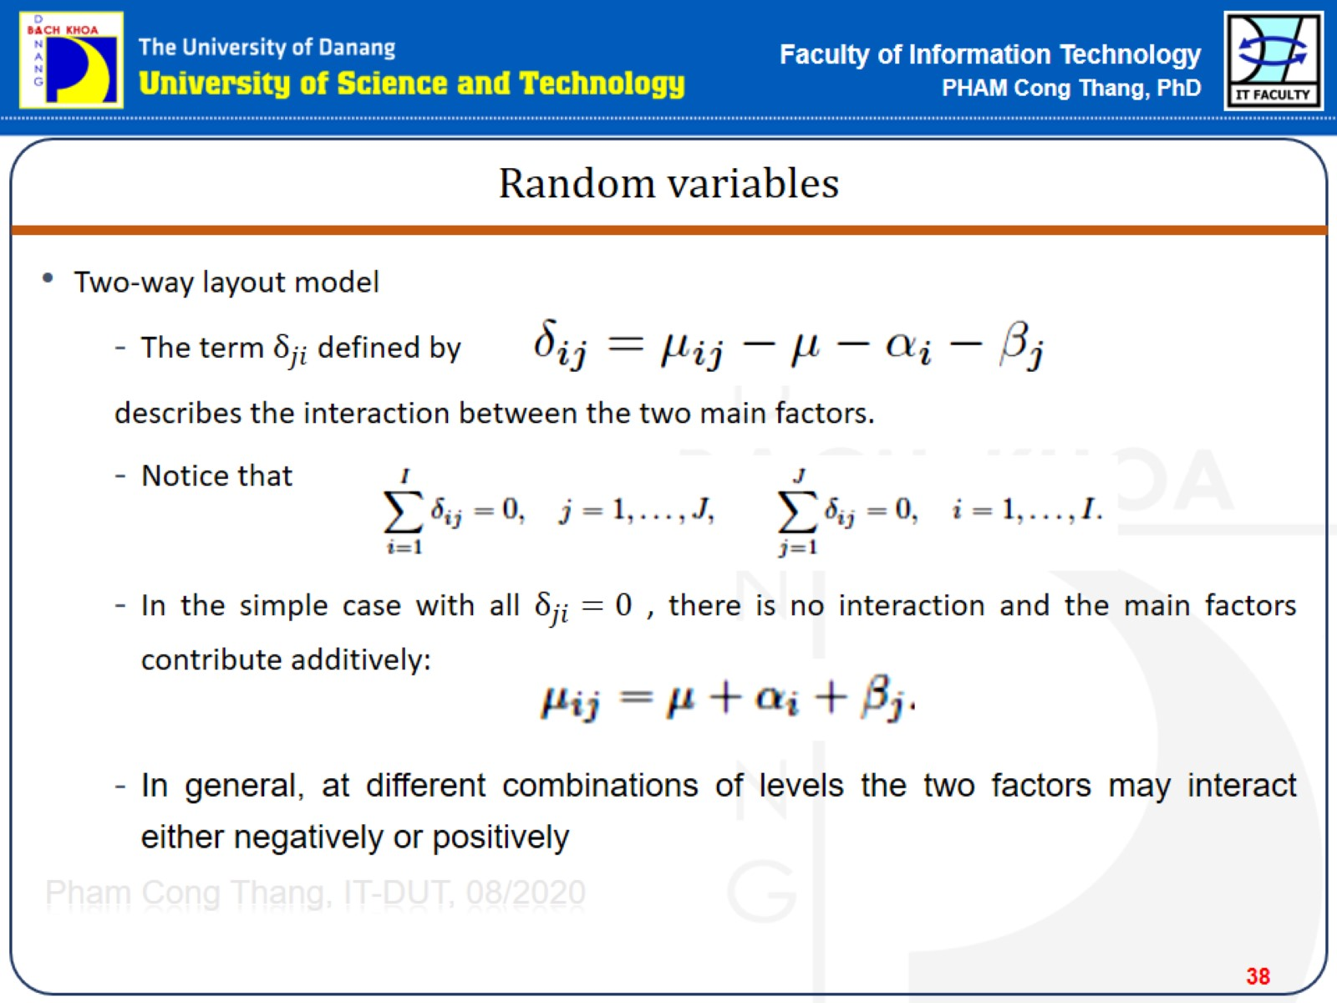
Random variables

Slide 39
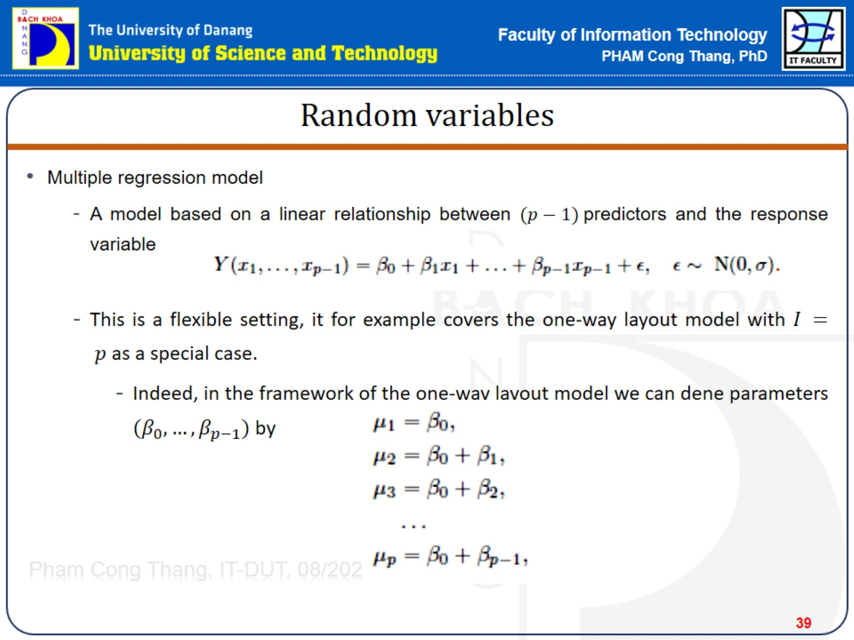
Random variables

Slide 40
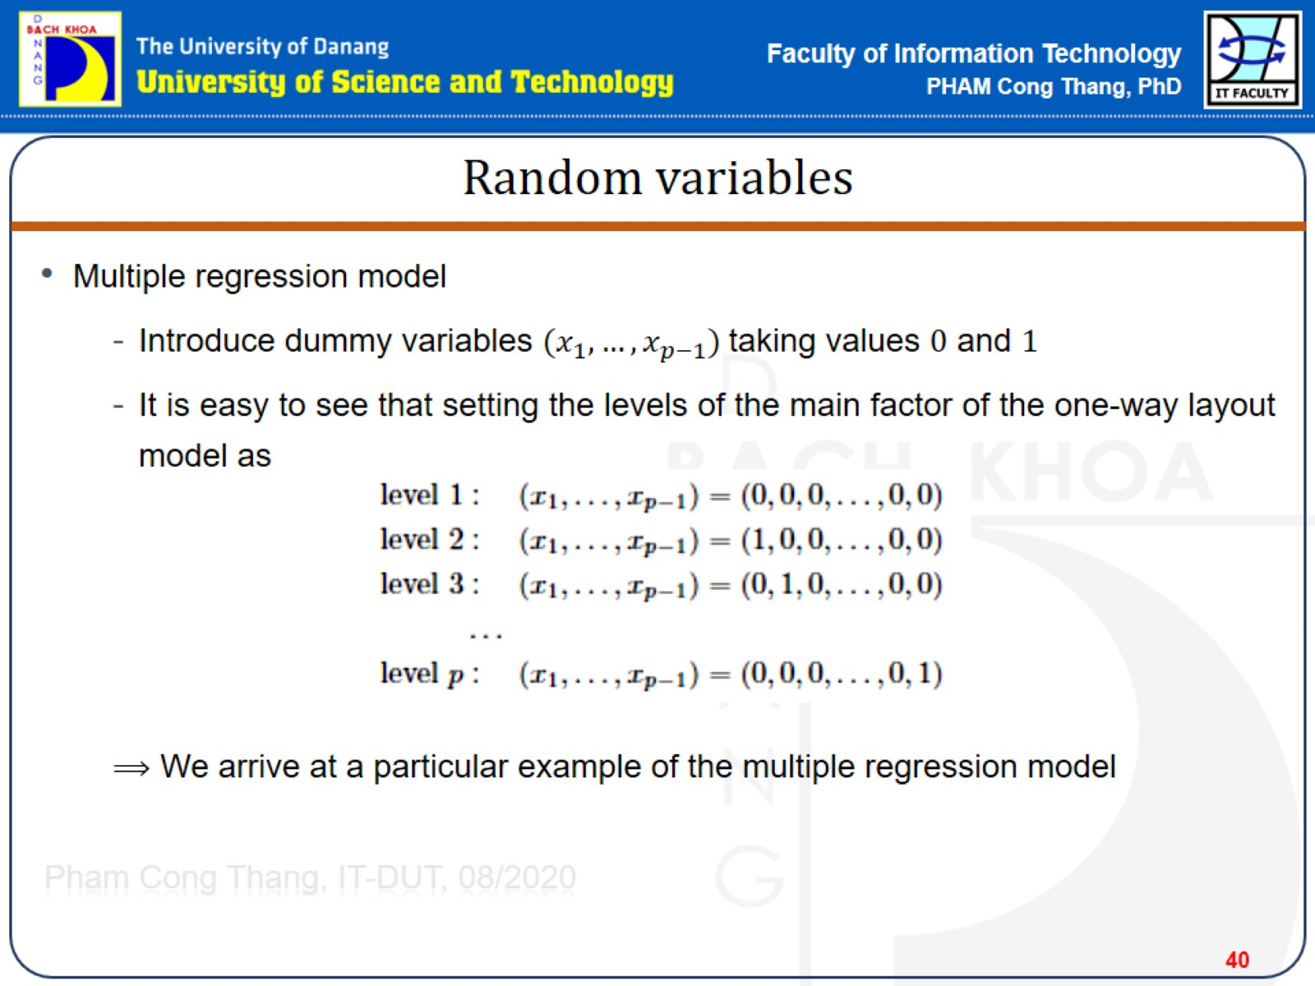
Random variables

Slide 41
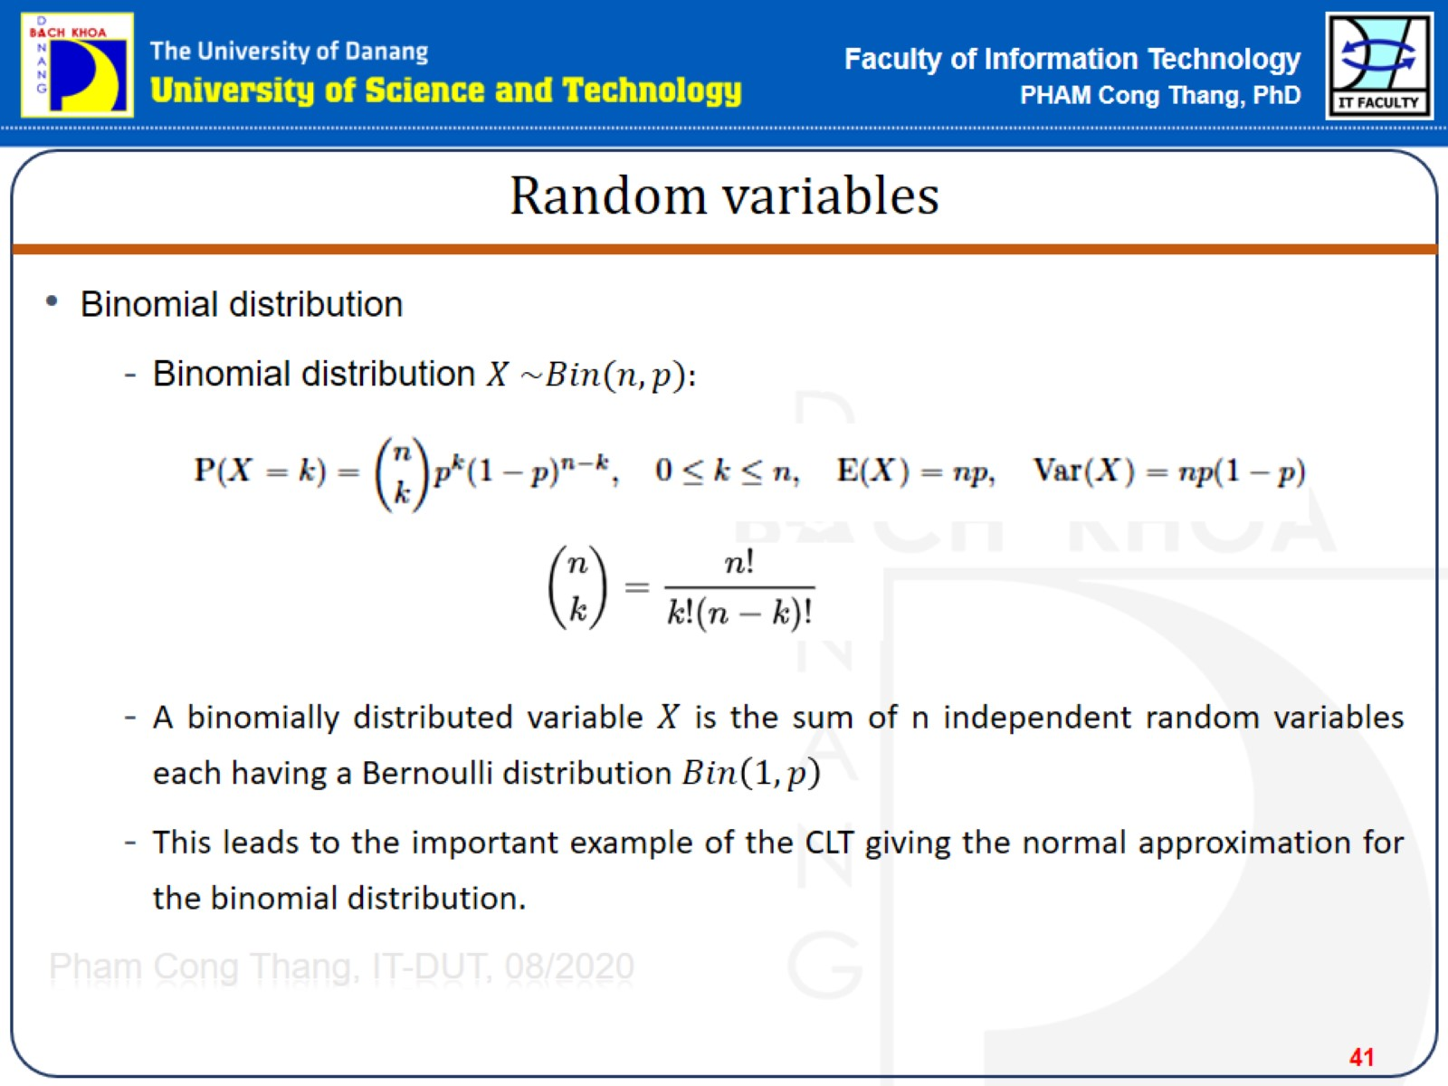
Random variables

Slide 42
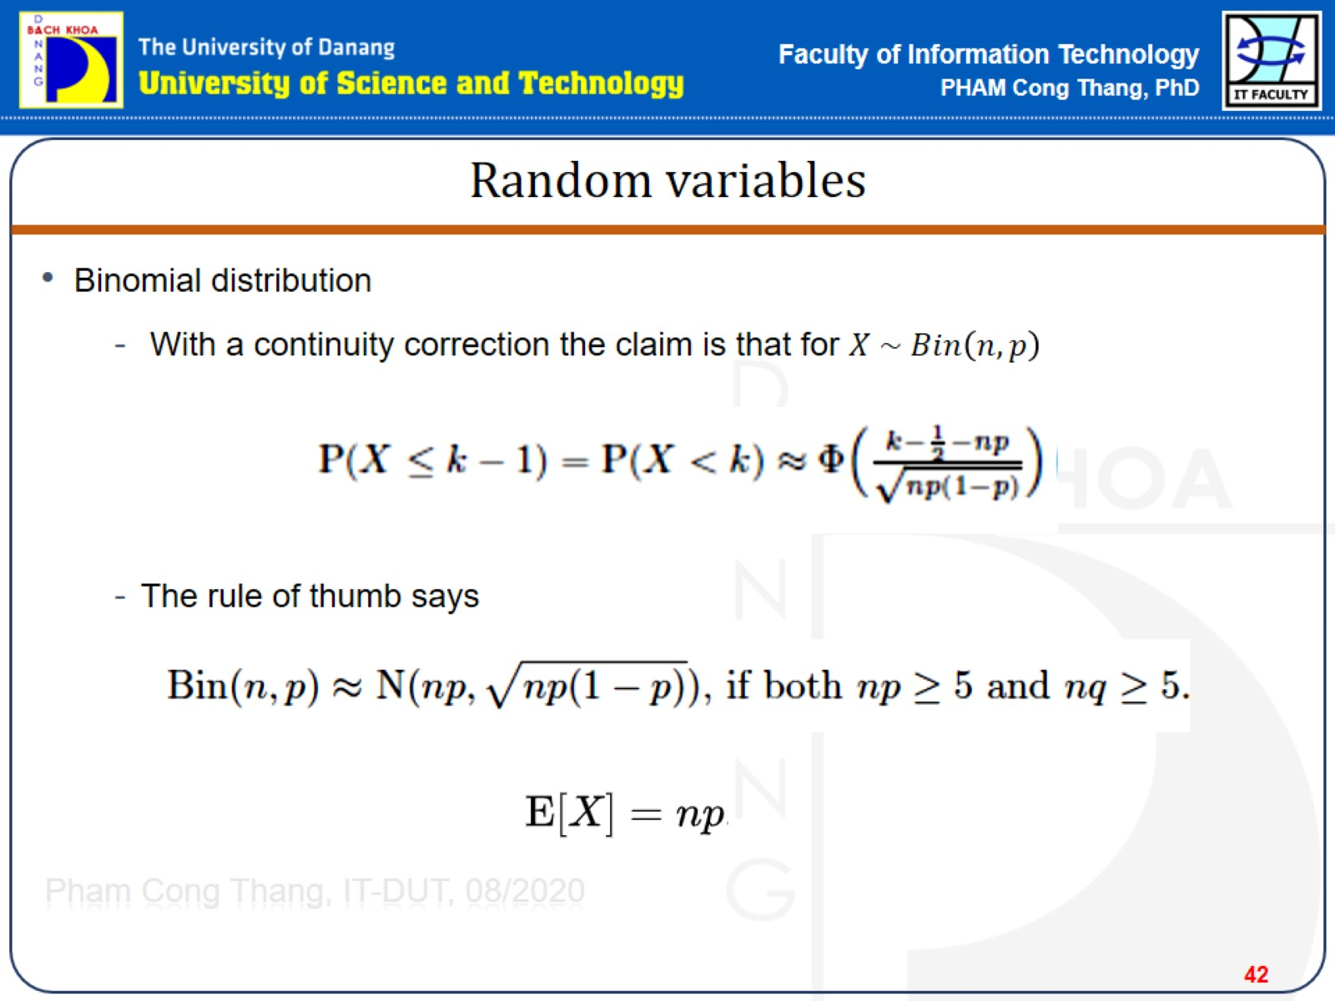
Random variables

Slide 43
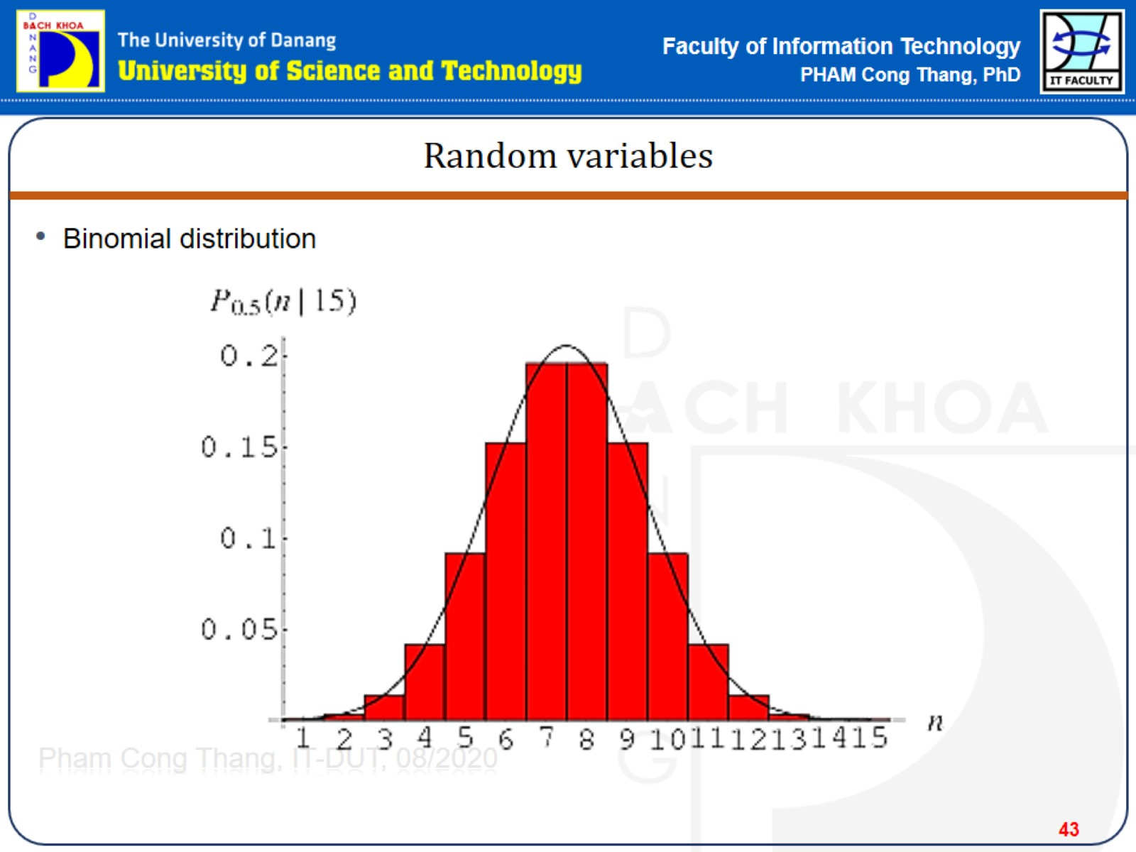
Random variables

Slide 44
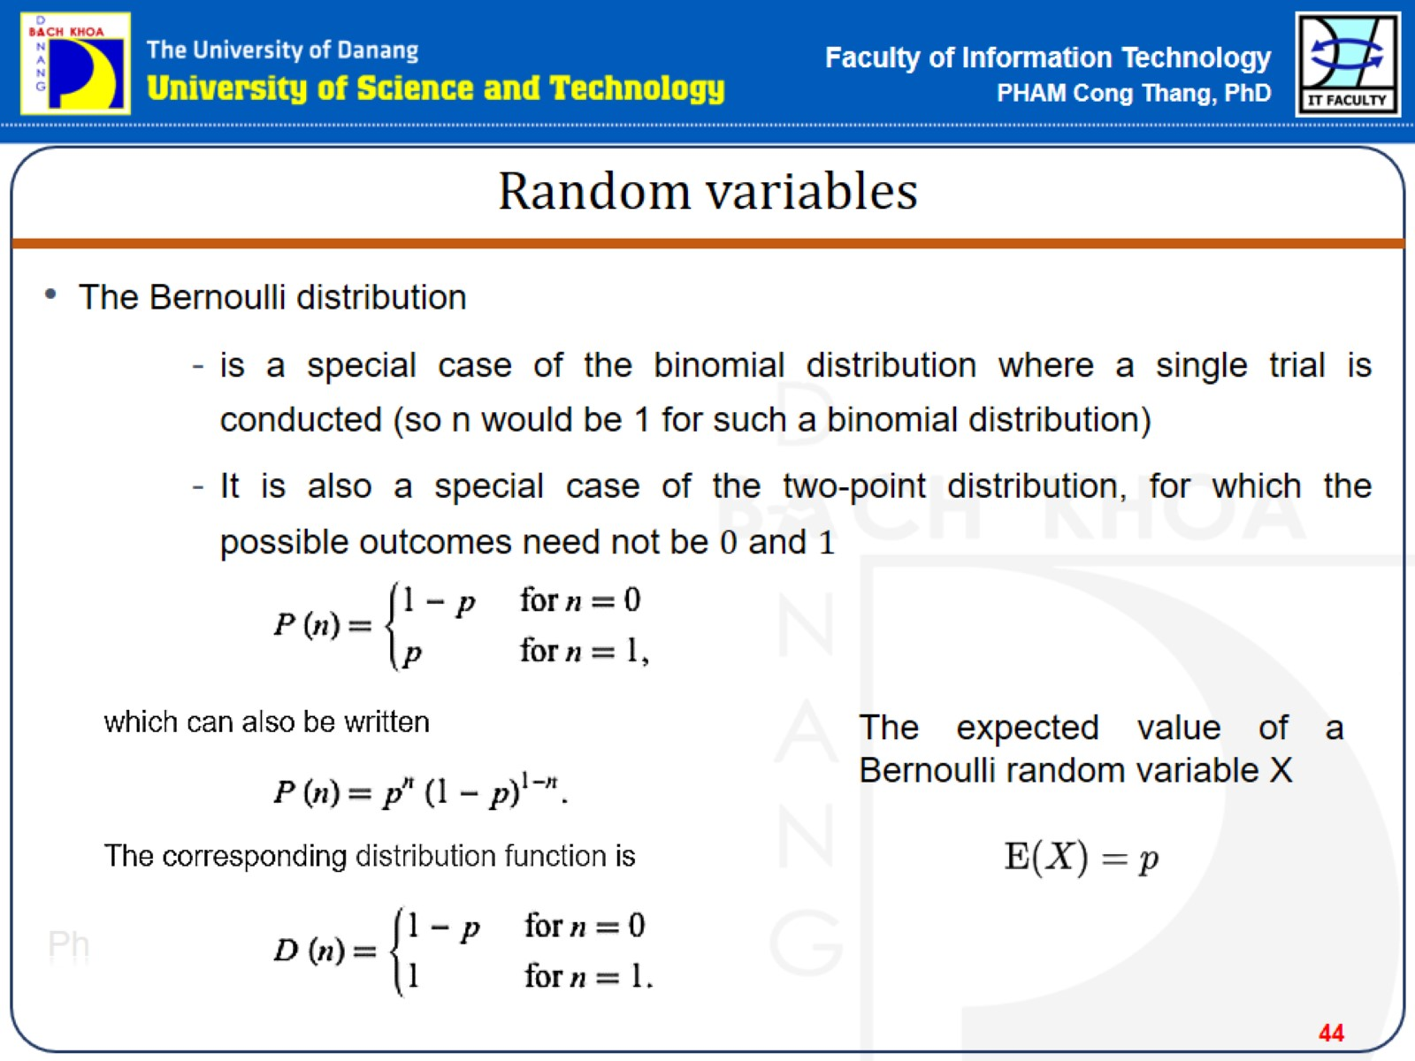
Random variables

Slide 45
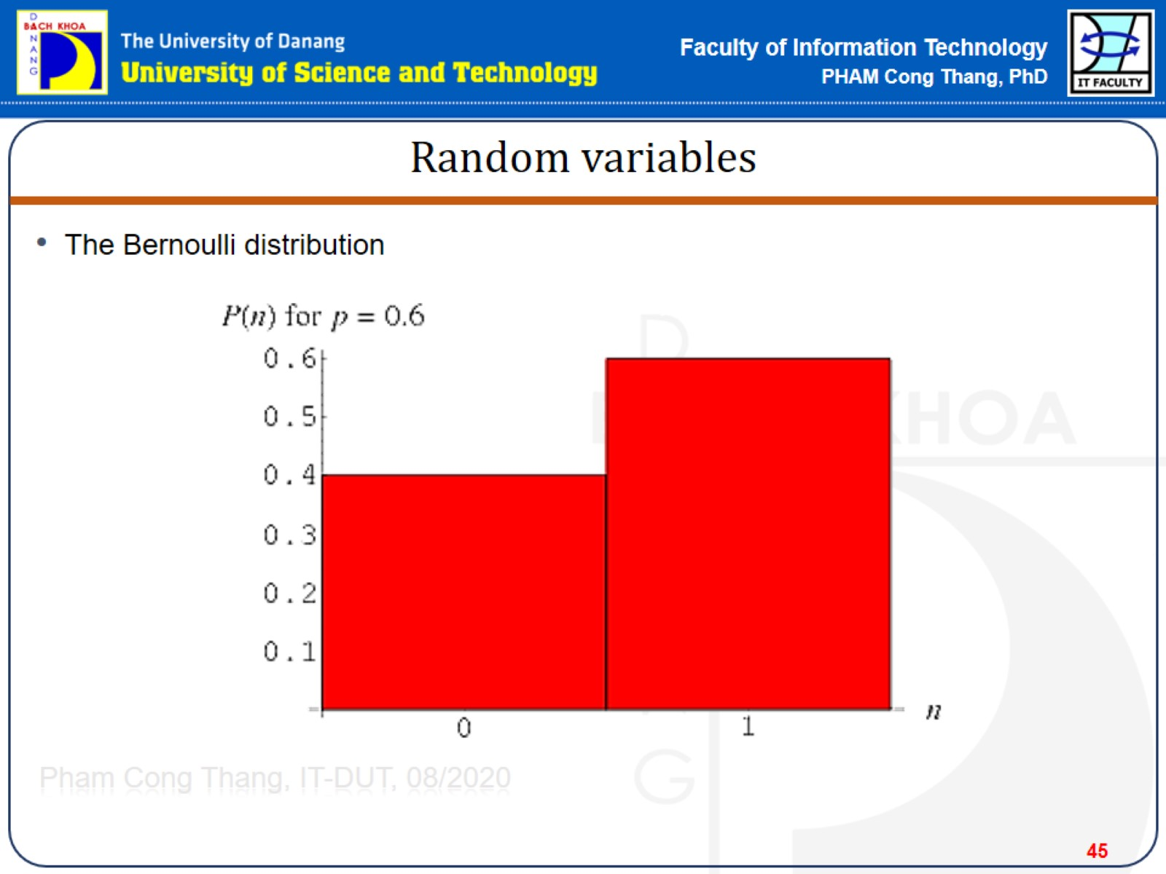
Random variables

Slide 46
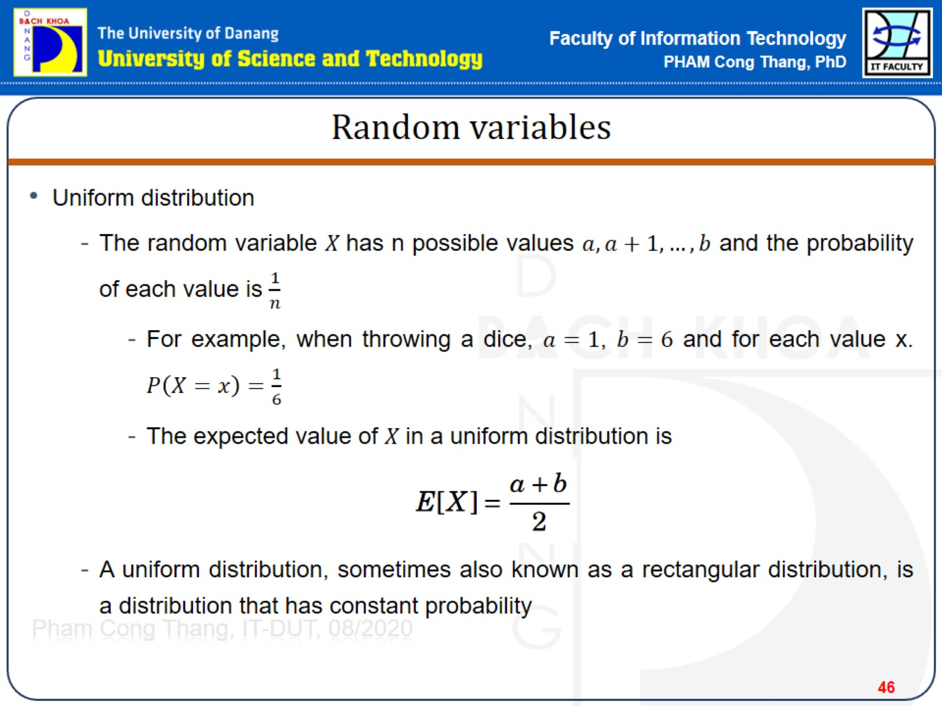
Random variables

Slide 47
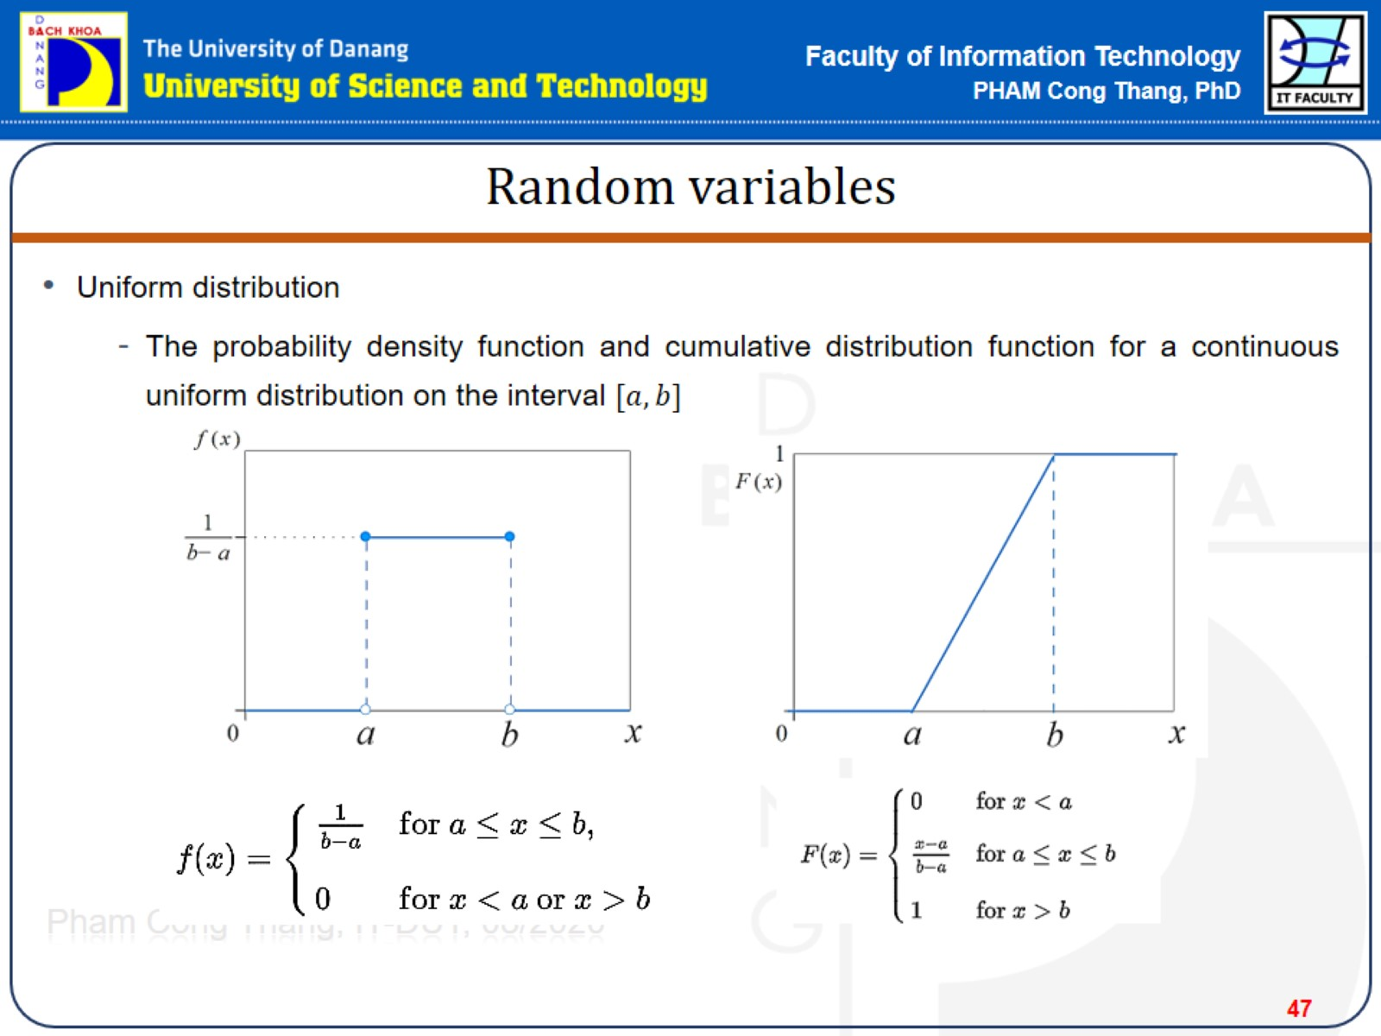
Random variables

Slide 48
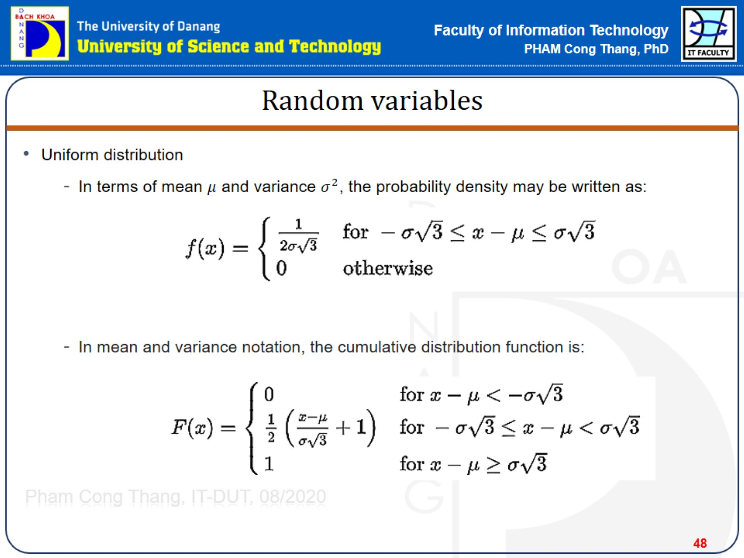
Random variables

Slide 49
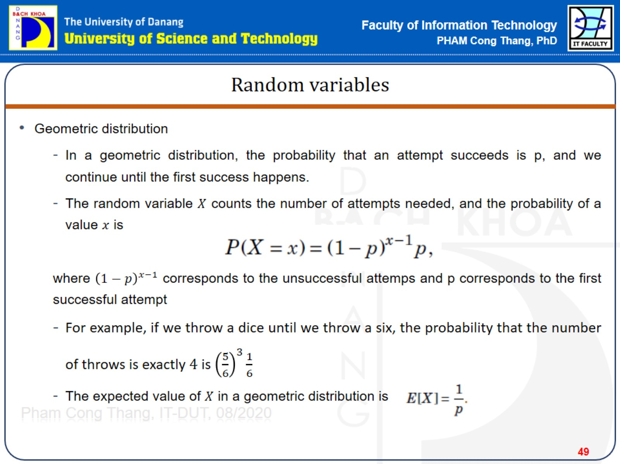
Random variables

Slide 50
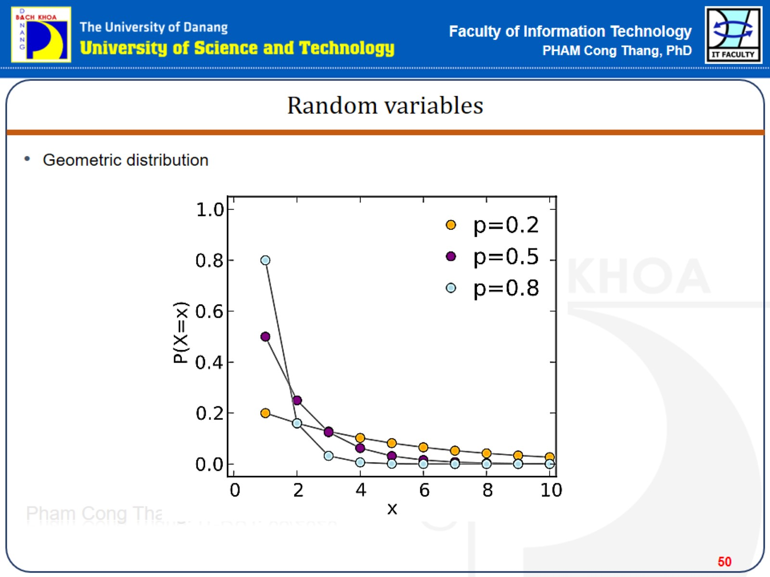
Random variables

Slide 51
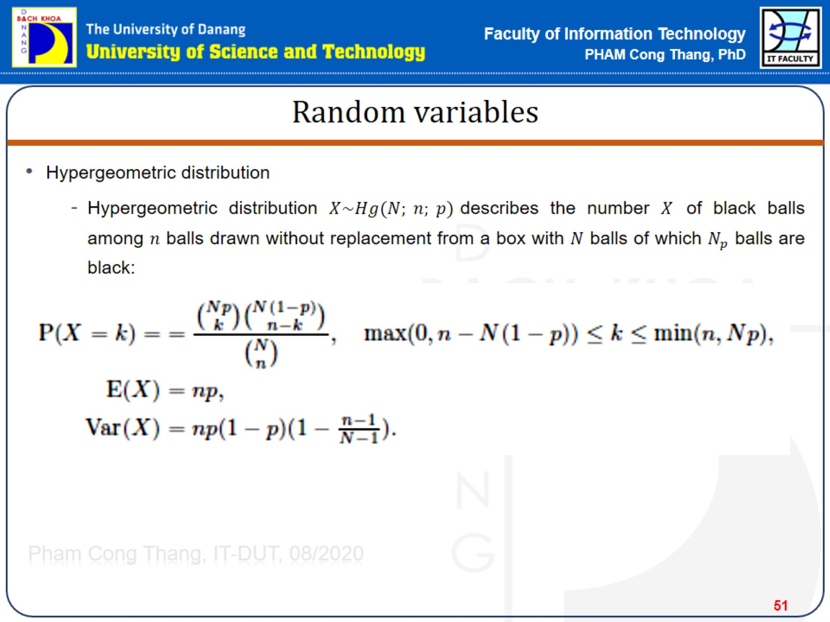
Random variables

Slide 52

Random variables

Slide 53

Random variables

Slide 54

Random variables

Slide 55

Random variables

Slide 56

Random variables

Slide 57

Random variables

Slide 58

Random variables

Slide 59

Random variables

Slide 60

Random variables

Slide 61

Random variables

Slide 62

Random variables

Slide 63

Random variables

Slide 64

Probability

Slide 65

Markov chains

Slide 66

Markov chains

Slide 67

Markov chains

Slide 68

Markov chains

Slide 69


Slide 70

Markov chains

Slide 71

Markov chains

Slide 72

Markov chains

Slide 73


Slide 74

Markov Chains

Slide 75

Markov chains

Slide 76

Markov chains

Slide 77

Markov chains

Slide 78

Markov chains

Slide 79

Markov chains

Slide 80

Markov chains

Slide 81

Markov chains

Slide 82

Markov chains

Slide 83

Markov chains

Slide 84

Markov chains

Slide 85

Markov chains

Slide 86

Markov chains

Slide 87

Markov chains

Slide 88

Markov chains

Slide 89

Markov chains

Slide 90

Markov chains

Slide 91

Markov chains

Slide 92

Markov chains

Slide 93

Markov chains

